Slide 1
Scalable Architecture using Microservices
Module 6
Simplifying with Event Modeling, Event Sourcing, and CQRS
Jeppe Cramon
CTO – Trustworks
© Copyright Trustworks 2025

Slide 2
Events
“An Event describes a FACT, i.e. something that HAS happened”
An Event is non-prescriptive of what should happen in other parts of the system.
An event will typically be published to multiple consumers/subscribers:
  The publisher of the event does not know who the subscribers are
  And the publisher doesn’t know what the subscribers intend to do with the event
Events always carry a name in its past-tense form:
OrderWasAccepted
OrderHasShipped
CustomerWasReimbursed

Slide 3
How do we discover events?

Slide 4
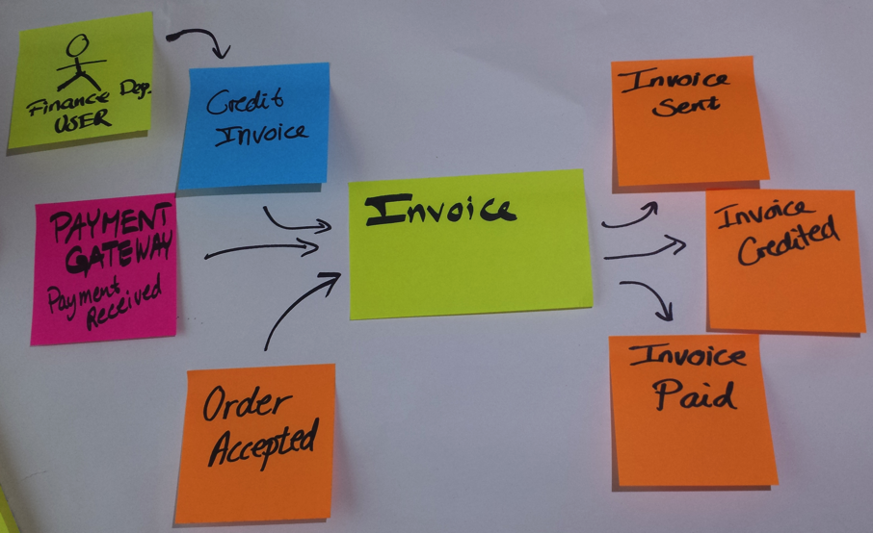
Event Storming
Event Storming is a fun way of bringing developers and business experts together and drive your analysis from the outside and quickly explore complex business domains in hours instead of days/weeks.

Slide 5

Event Storming
Event Storming (or Model storming) is a way of starting your analysis from the outside and quickly explore complex business domains.
Invented by Alberto Brandolini
  See https://ziobrando.blogspot.dk/2013/11/introducing-event-storming.html

Slide 6
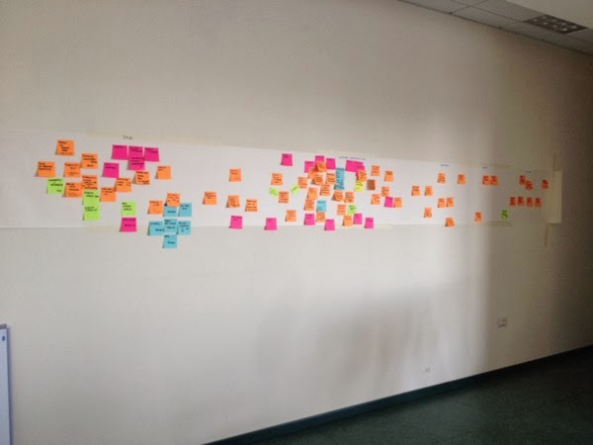
Event Storming
Invite the right people
  people with questions and people with answers. They provide the perfect mix of curiosity and wisdom.
Provide unlimited modeling space

Slide 7
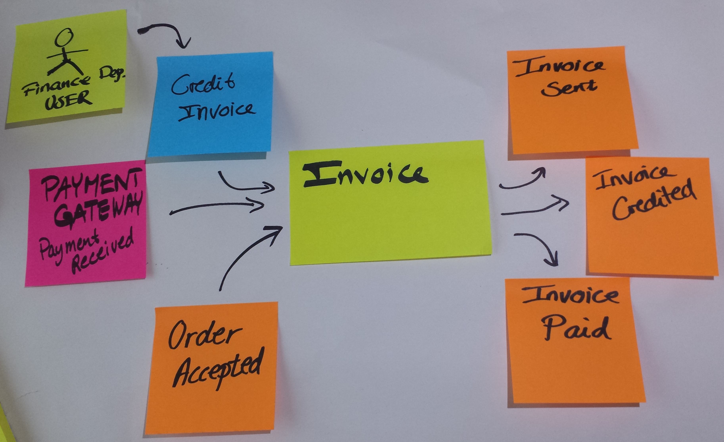
How to run an Event Storming Workshop
Explore Aggregates Outside In
  An Aggregate receives Commands and decides to execute them or reject them
  If the Aggregate executes a Command it will produce one or more Domain Events as a result

Slide 8
How to run an Event Storming Workshop
Explore Bounded Contexts
  During the discussion, some conflict areas with regards to different interpretations of terms might emerge
  Draw boundaries between the multiple consistent models that will coexist in your domain.
Accept Order
Order
Order
Order
Accepted
Order Delivered
Sales
Delivery

Slide 9
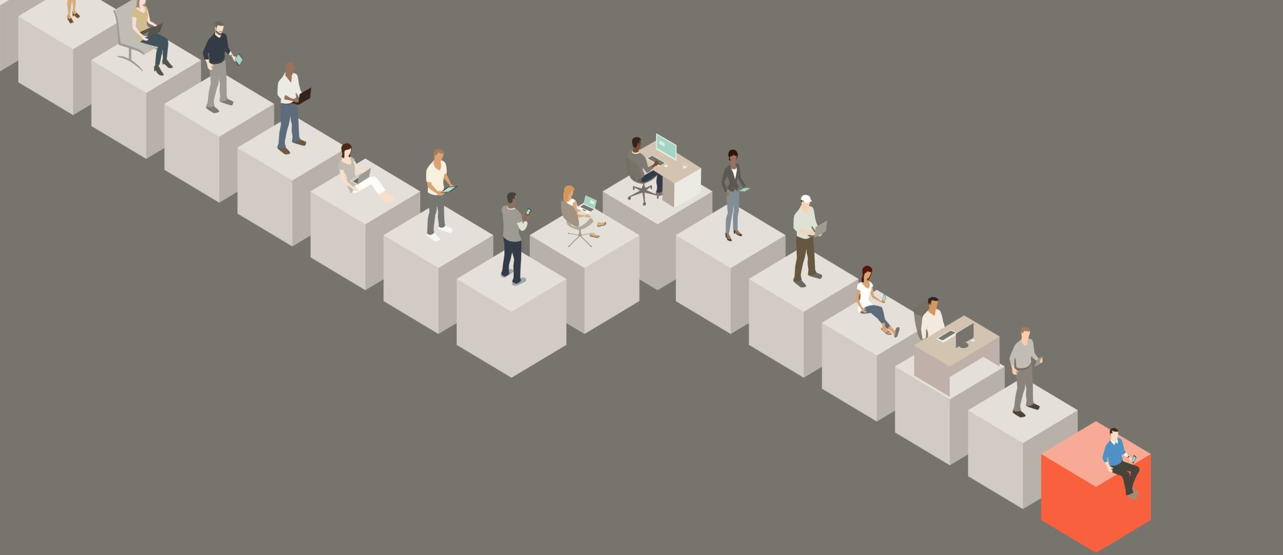
Event Modeling

Slide 10
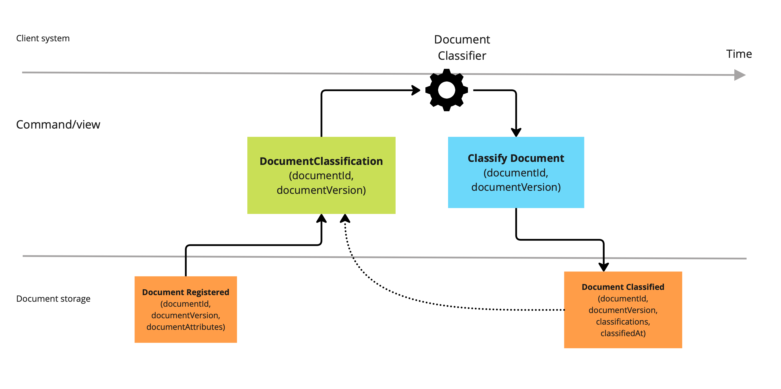
Event Modeling: The Visual Story of Your System
A Timeline of Your Business
Chronological mapping of information flow
Shows exactly how information transforms over time
A complete visual story from beginning to end
A Universal Language
Business and technical stakeholders share one model
Captures what happens, not just how it happens
Natural storytelling approach that mirrors how people think
"Event Modeling creates a visual story that everyone can follow - from CEOs to developers to business analysts."

Slide 11
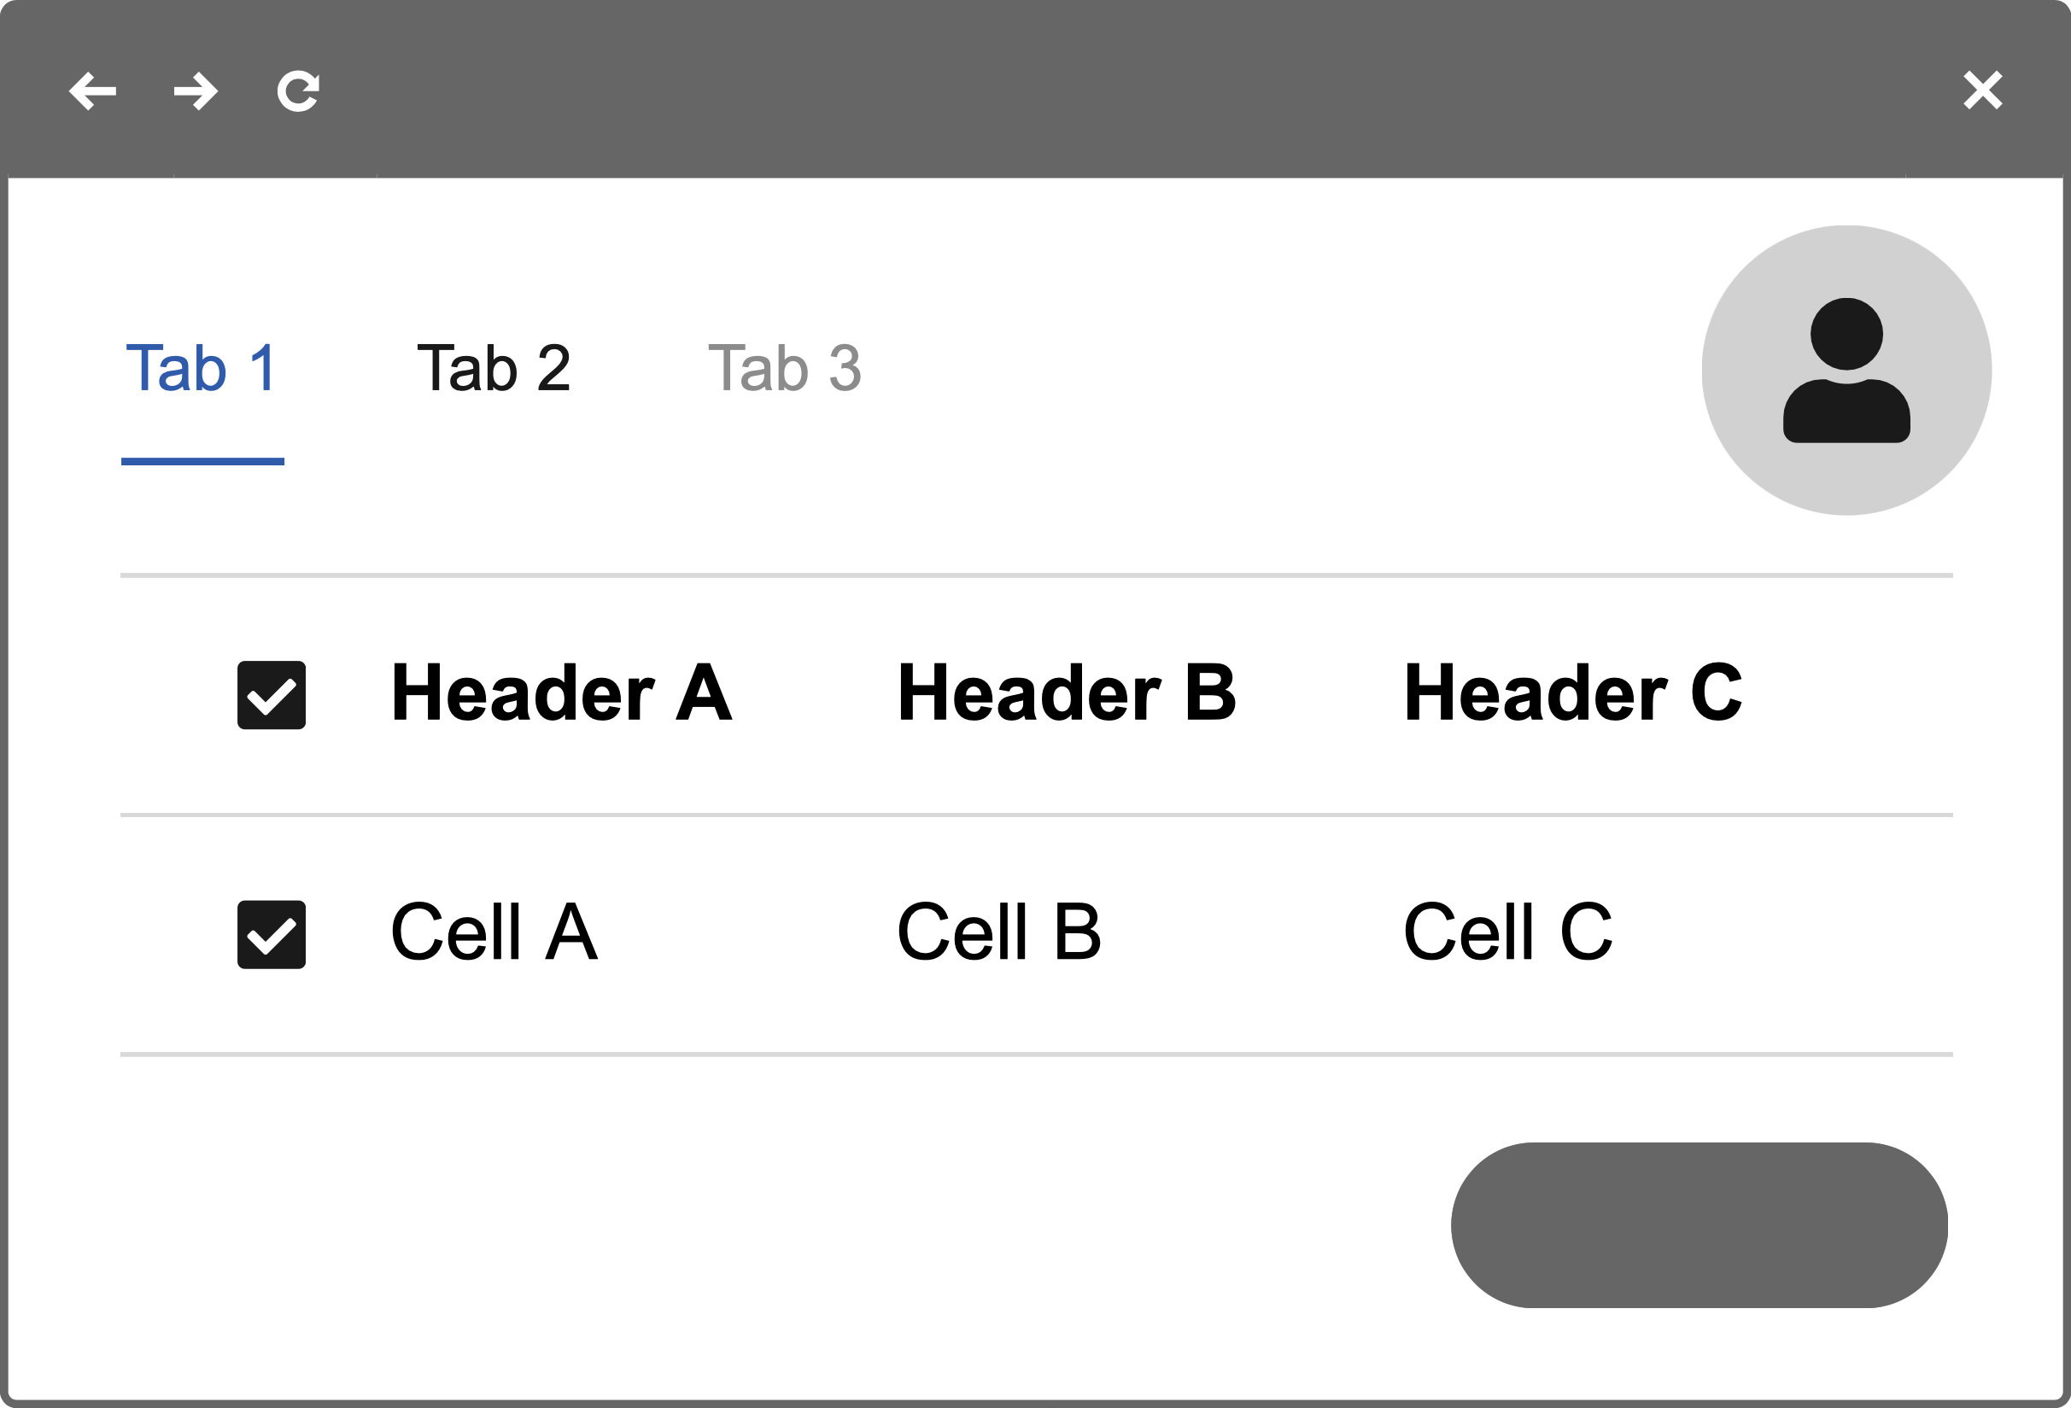
The Building Blocks of Event Modeling
Triggers (API or UI)
What initiates actions
User interactions, API calls, scheduled tasks
The starting point of each business process
Commands (Blue)
Intentions to change the system
Carries all information needed to make a decision
Example: PlaceOrder, TransferFunds, RegisterUser
Events (Yellow/Orange)
Immutable facts recording what happened
The "source of truth" for the entire system
Example: OrderPlaced, FundsTransferred, UserRegistered
Views (Green)
Information prepared for reading
Updated based on events that have occurred
Optimized for specific business needs
Example: Pending Orders, Customers Order History
Command
Event
View
"These simple building blocks combine to model your entire business system in a clear, visual way."

Slide 12
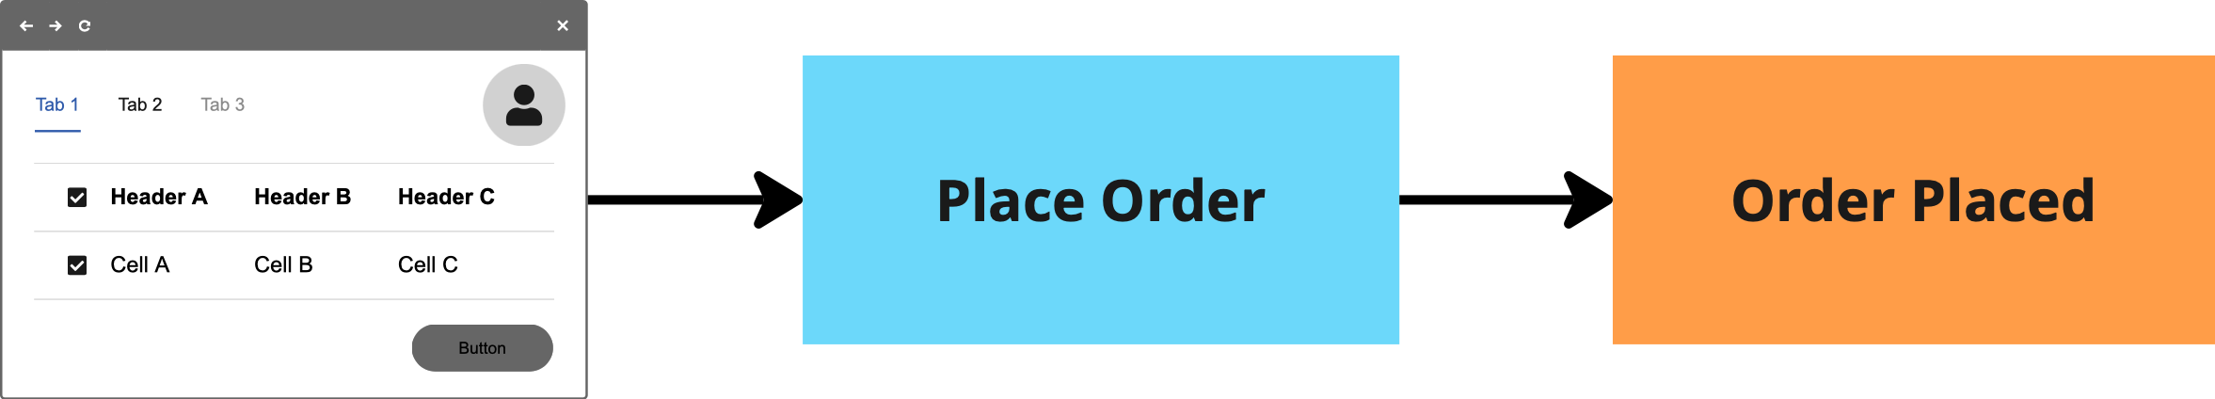
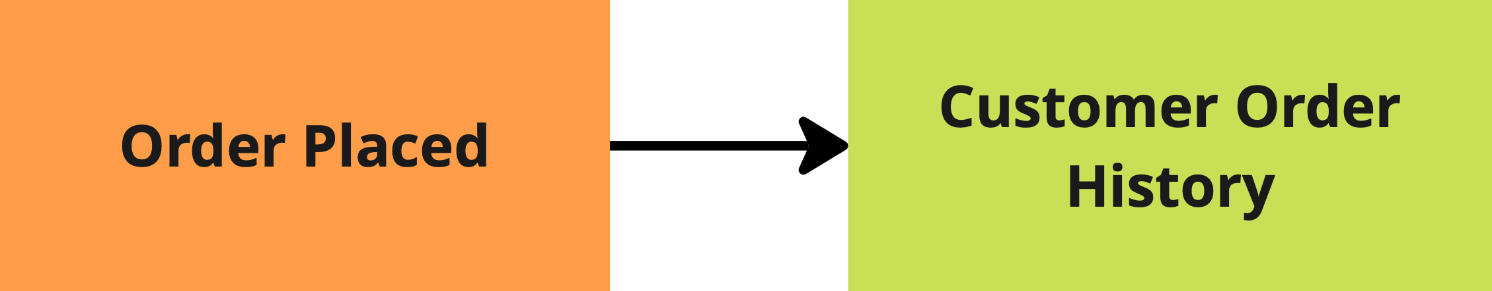
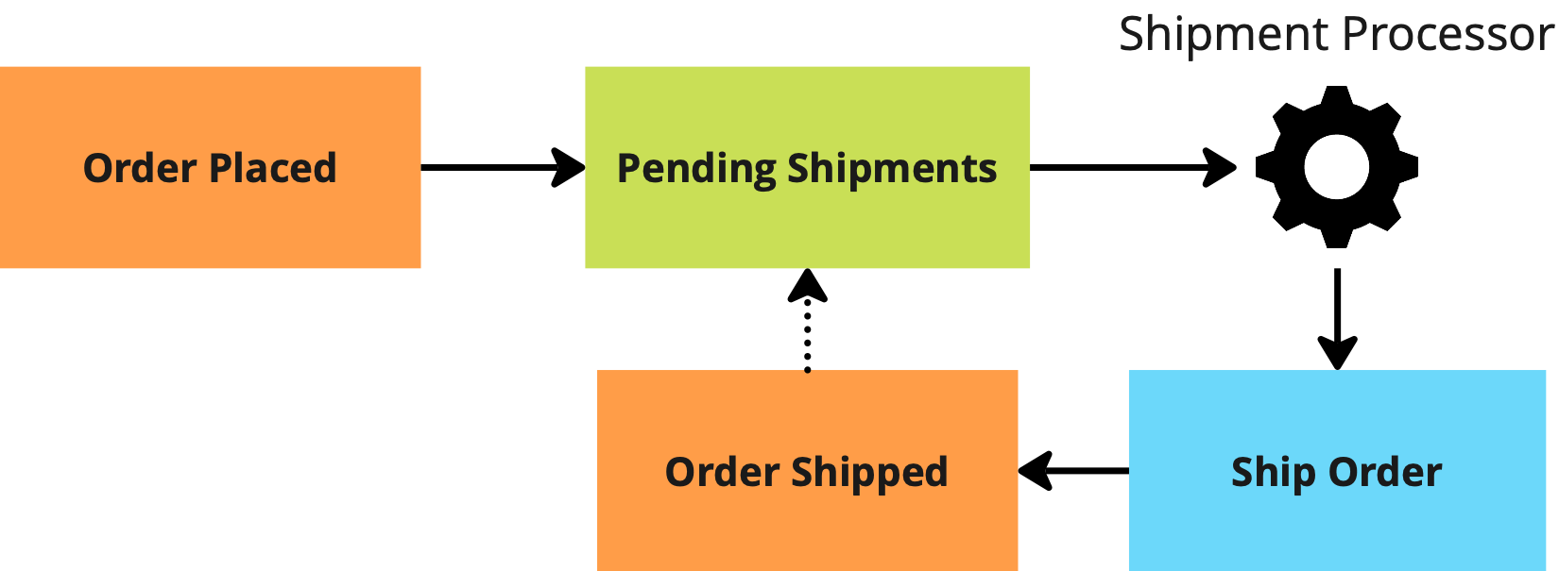
The Power of Patterns
Command Pattern
How user actions change system state
Trigger → Command → Event
Example:
User clicks "Place Order" → PlaceOrder command → OrderPlaced event
View Pattern
How events transform into useful information
Event(s) → View
Example:
OrderPlaced event → Customer Order History view
Automation Pattern
How the system responds to events automatically
Event → To-Do View → Automated Trigger → Command → Event
Example:
OrderPlaced → Pending Shipments → Shipment Processor → ShipOrder → OrderShipped
"These patterns repeat throughout your system, creating a consistent, understandable structure."

Slide 13
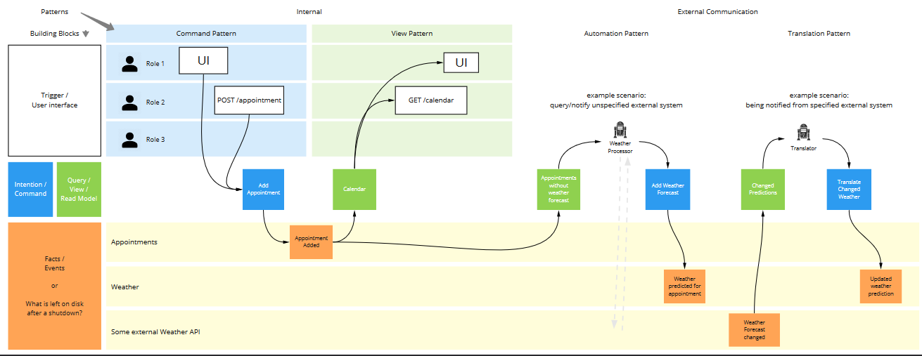
UI/API/JOB
The trigger for a use case can be:
User interacting via a UI
An external piece of software calling a public API
A job automating a process step
Command
A command is used to indicate an intention to to invoke a process step
Commands are sent from the UI, API or job
Event
Describes a business fact due to a change to system state
View
Describes data projections based on past events, that can be queried by:
UI’s (e.g. a Grid or Form view)
API’s
Jobs with Todo Lists

Slide 14
What is event modelling?
Graphical System Representation
Graphically depicts a system's evolution over time using a timeline of events, showing how various components and interactions have led to its current state
Timeline-Based Analysis
Event Modeling uses a timeline to depict different steps or events in the system, offering a chronological perspective
Event-Centric Architecture
The approach is ideal for specifying systems that are based on event sourcing, where events are the primary source of truth
Collaborative Tool
It facilitates collaboration across different roles within an organization, providing a common language and understanding.
Enhanced Product Understanding
It provides a clear view of how a product was developed, improving understanding for both current and future development efforts using a shared language
Simplicity, Accessibility and predictability
The methodology is straightforward and can be quickly incorporated into various organizational practices
Tests are central to specifying expected system behavior

Slide 15
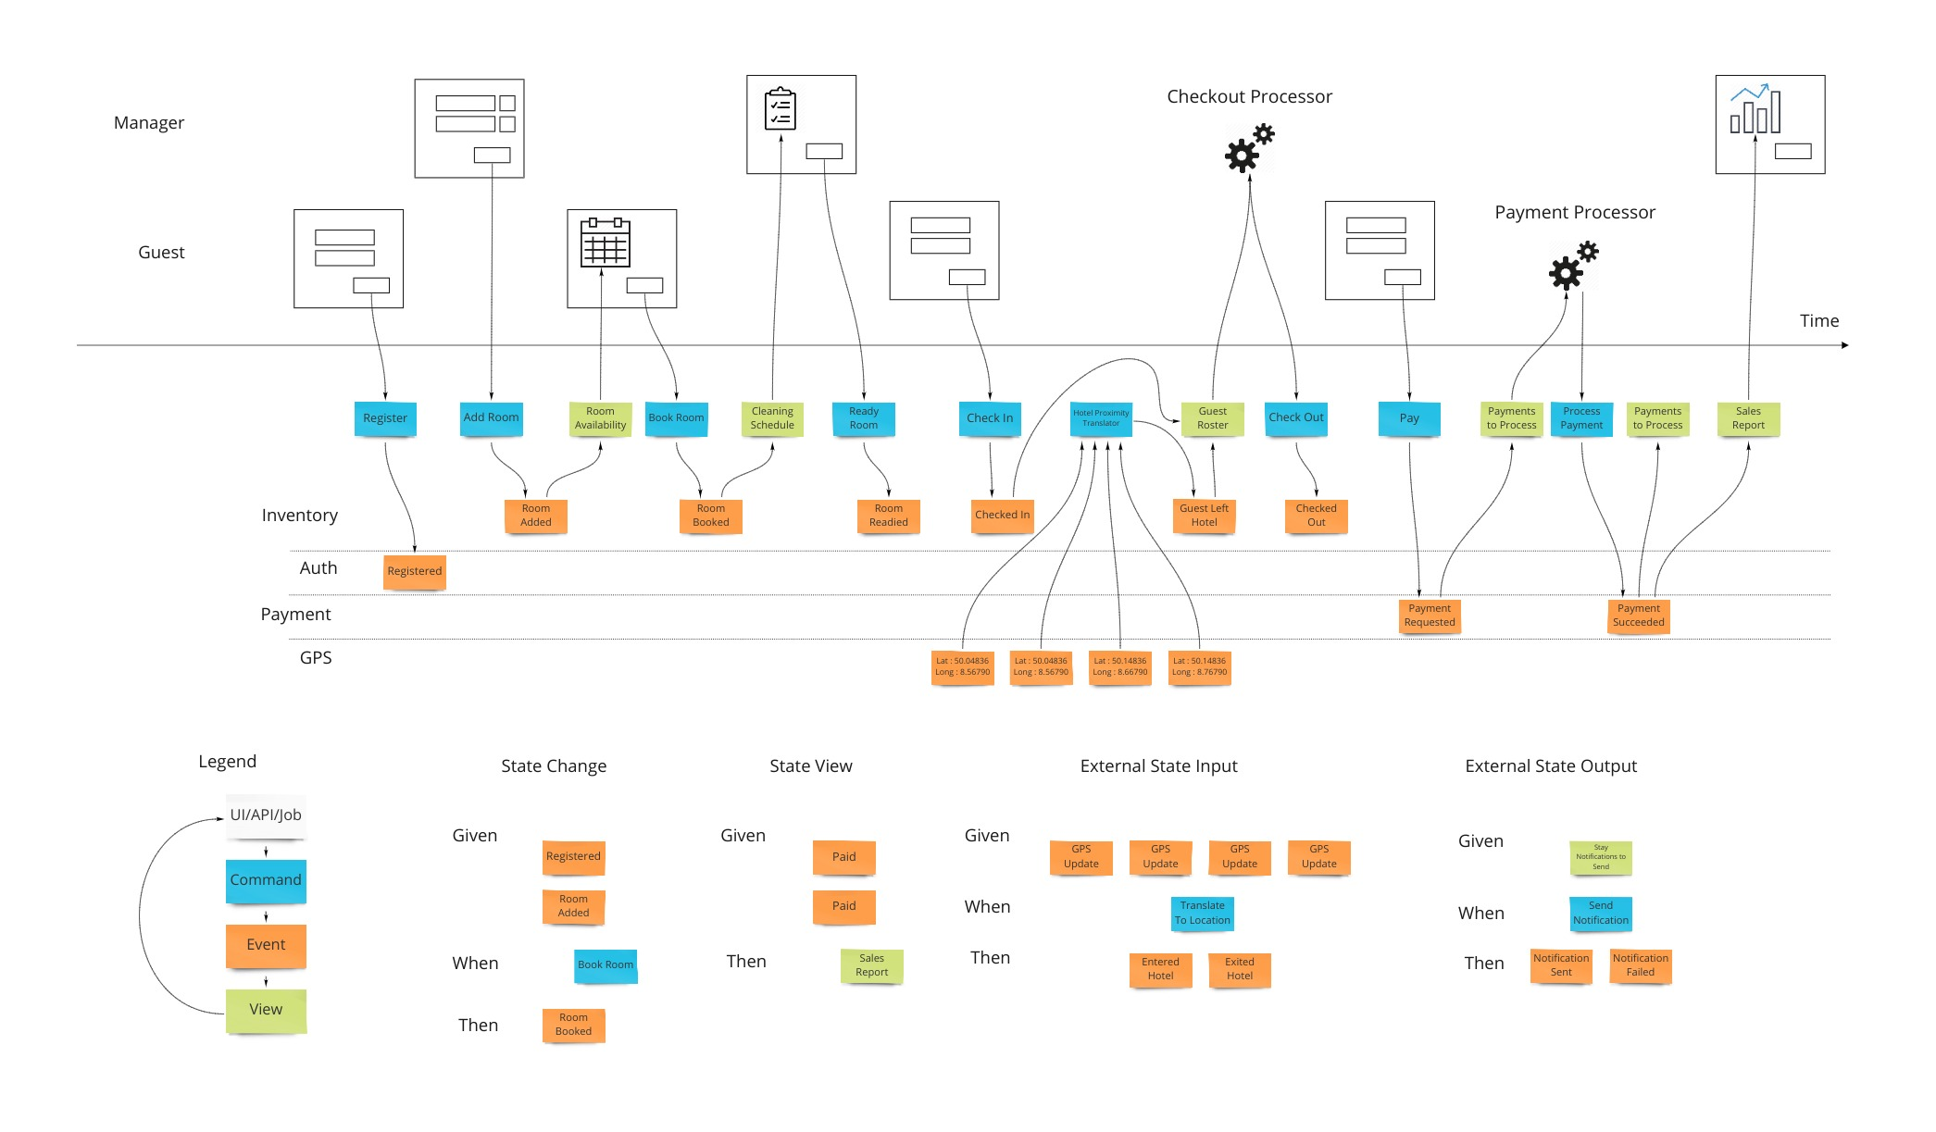
Event Modeling
https://eventmodeling.org/posts/what-is-event-modeling/

Slide 16
Event modeling example

Slide 17
Slices: The Units of Business Value
Complete End-to-End Functionality
From user action to stored data and back
Self-contained units of business value
Independently implementable
The Perfect Unit of Work
Clear scope boundaries
Testable with clear acceptance criteria
Can be owned by a single team or developer
Examples of Slices:
Place an order for products
Cancel an existing order
View order history by customer
Process payment for an order
"Slices are the perfect unit of work - small enough to implement quickly, but complete enough to deliver real business value."

Slide 18
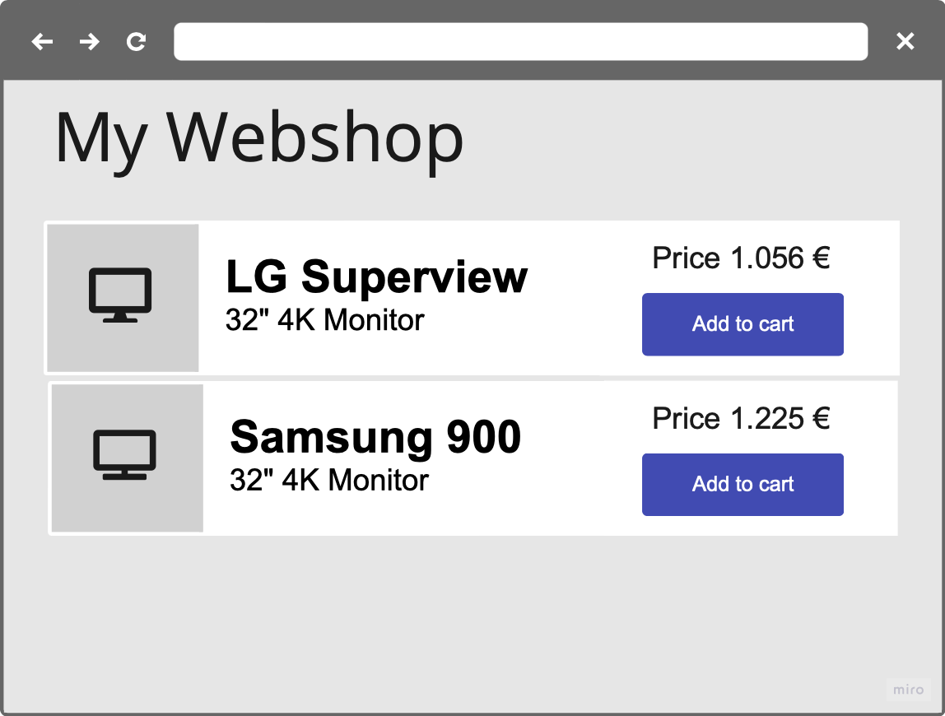
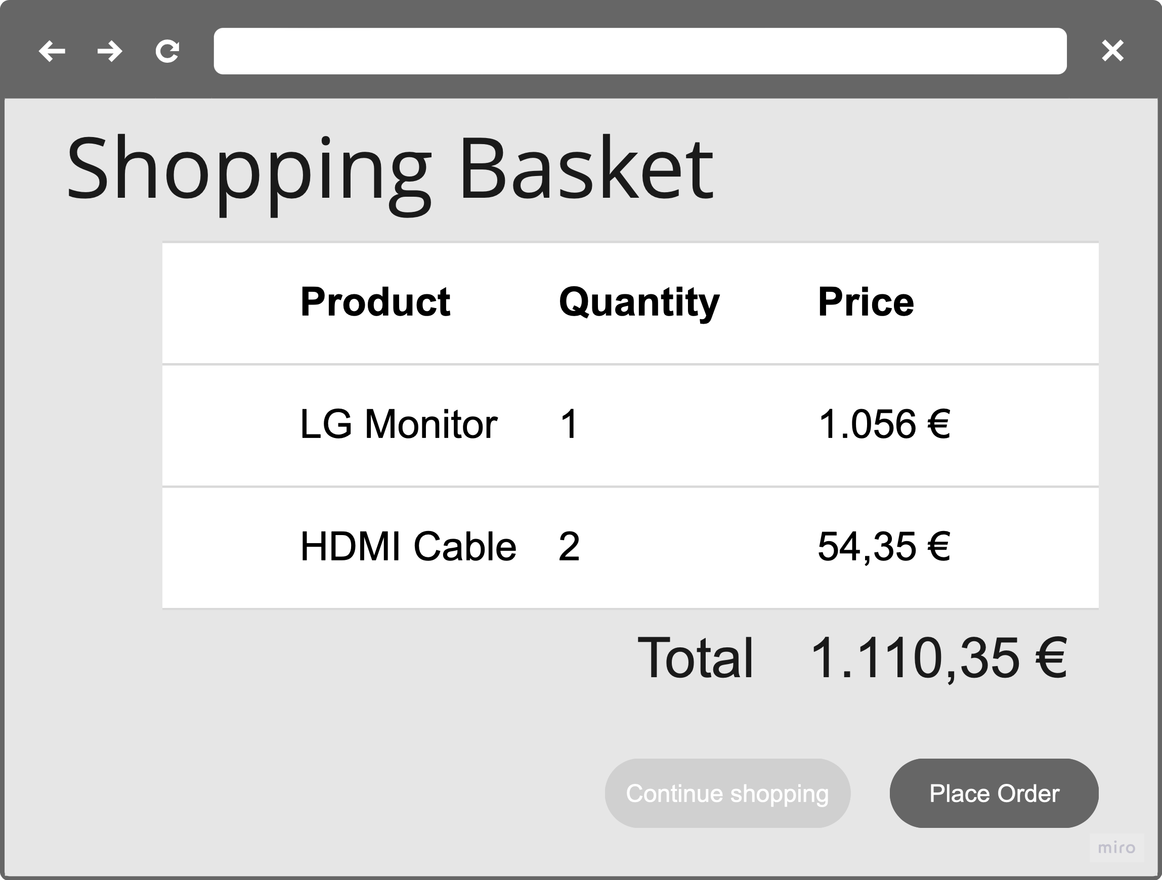
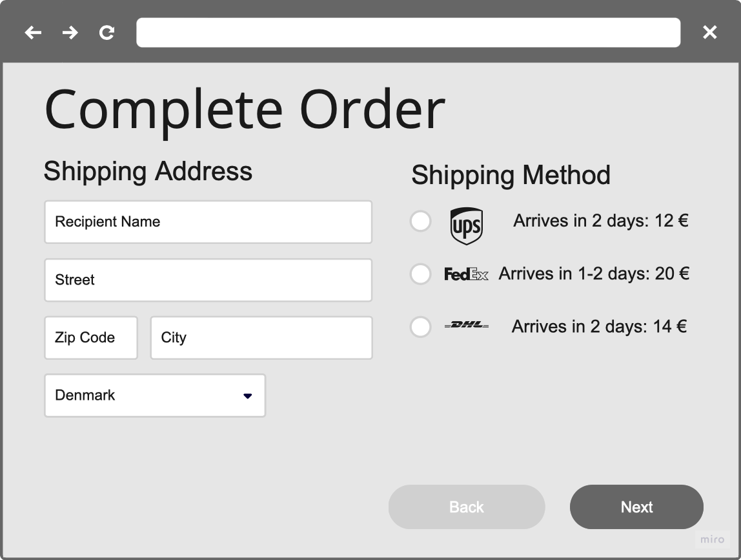
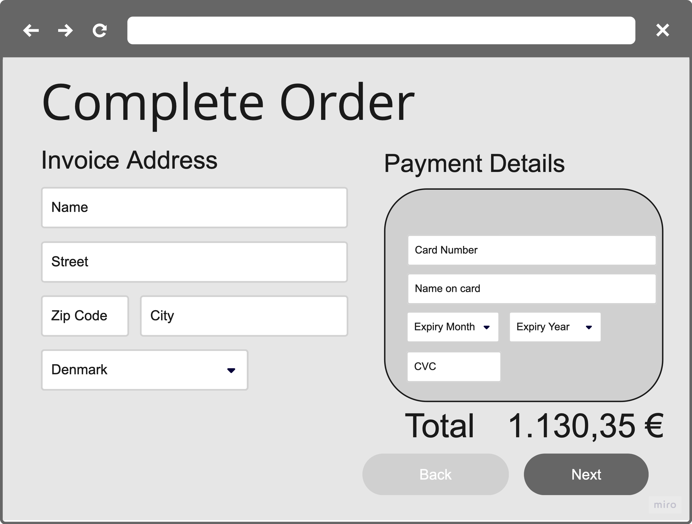
Autonomous Business Capabilities
Business-Aligned Components
Software organized around business functions, not technical layers
Clear ownership boundaries that match organizational structure
Independent evolution at different rates as business needs change
These are the swimlanes in Event Modeling
What Makes a Capability "Autonomous"?
Owns its data and business rules
Makes decisions independently
Communicates through well-defined interfaces
Can be deployed and scaled independently
Example Capabilities:
Order Management
Customer Account Management
Inventory Management
Payment Processing
Web App
Add Item to
Shopping Basket
(basketId, productId)
Shopping Basket
(basketId,…)
Request CheckOut
(baskedId, orderId)
Shopping Basket
(basketId, orderId,…)
Add Shipping Details to Order
(orderId,
shippingAddress,
shippingMethod)
Order
Shipping Details
(orderId,…)
Sales
Item Added to Shopping Basket
(basketId, productId)
CheckOut
Requested
(basketId, orderId)
Shipping
ShippingDetailsAdded
(orderId,
shippingAddress,
shippingMethod)
Payment
"Autonomous capabilities allow your organization to evolve different parts of the system at different rates, based on business priorities."

Slide 19
Estimation Certainty: Finally Predictable Development
Why Estimation Works with Slices
Clearly defined inputs and outputs
Limited scope with visible boundaries
Standard patterns with predictable implementations
No hidden dependencies between components
Comparison to Traditional Estimation
Traditional projects: +/- 50-100% accuracy common
Slice-based projects: +/- 15-25% accuracy achievable
Team confidence in estimates increases dramatically
The Mathematics of Better Estimation
Smaller units of work have less variability
Standard patterns reduce unknown factors
Parallelization reduces critical path dependencies
Historical data becomes more relevant and applicable
"When you're estimating a well-defined slice with clear boundaries, you're no longer guessing - you're calculating based on real knowledge."

Slide 20
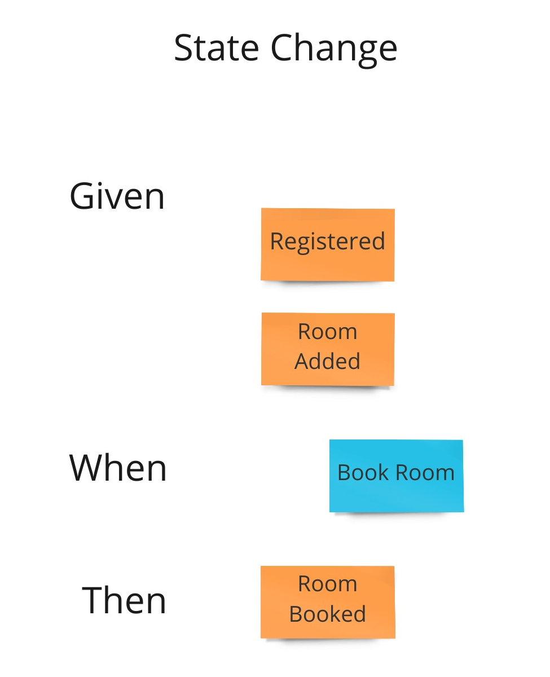
Testing: Built-In Quality
Given/When/Then from the Model
Tests derived directly from the event model (Given/When/Then test cases)
Each slice has clear acceptance criteria
Tests written before implementation begins
Complete Test Coverage
Unit tests for command handling and business rules
Integration tests for views and projections
End-to-end tests for complete slices
Example Test Scenario:
Given: A CustomerIsRegistered and a RoomAdded
When: The Customer tries to BookRoom
Then: An RoomBooked event is emitted with correct details
"Quality isn't added later - it's built in from the beginning through tests that directly reflect business requirements."

Slide 21
Event modeling by example

Slide 22
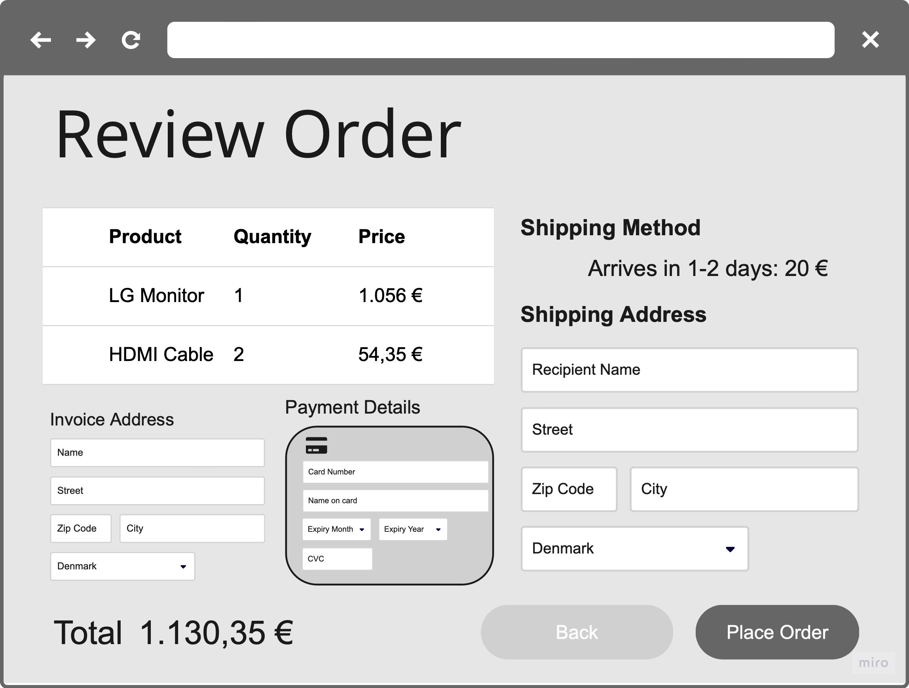
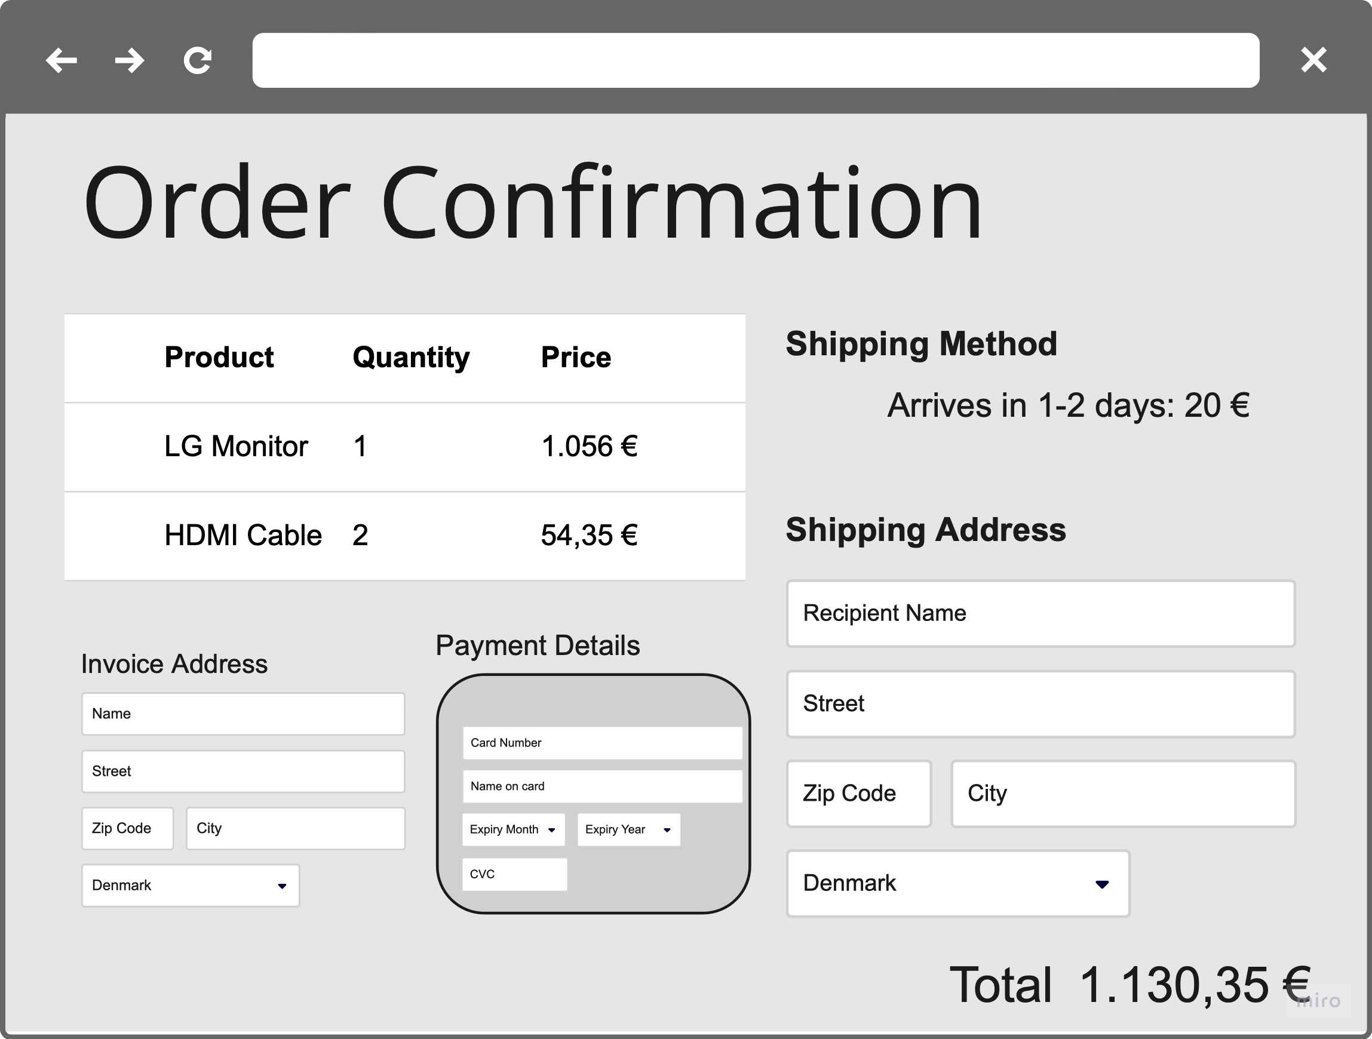
Sales system – order completion flow

Slide 23
Sales system – Find PRODUCT
Web App
Products For
Sale View
Product Added
Product Price Changed
Sales
Shipping
Payment

Slide 24
Event sourcing
What is it?
Benefits of event sourcing
Event Sourcing is a software architecture pattern where the state of an application is determined by a sequence of events.
Building blocks:
Events: Immutable records of something that has happened in the system.
Commands: Requests to perform an action or change state.
Aggregates: Entities that apply business rules and generate events (used less and less)
Event Store: A persistent log of all events
Historical Transparency: Easily trace and understand changes over time.
Auditability: Every state change is recorded.
Time Travel: Reconstruct past states by replaying events.
Decoupling: Components can react independently to events.
ProductAdded
Add
Product
Product
ProductEvents
Pattern: Command + State (Previous Events) = Event(s)

Slide 25
Event SOURCING
COMMAND
EVENT
Imperative naming
Always named in the past tense
data class AddProduct(
override val id: ProductId,
val name: String,
val price: Amount
) : ProductCommand
data class ProductAdded(
override val id: ProductId,
val name: String,
override val price: Amount
) : ProductEvent, HasProductPrice
data class ChangeProductPrice(
override val id: ProductId,
val price: Amount
) : ProductCommand
data class ProductPriceChanged(
override val id: ProductId,
override val price: Amount
) : ProductEvent, HasProductPrice
ProductAdded
ProductPrice
Changed
ProductPrice
Changed
ProductPrice
Changed
ProductPrice
Changed
ProductPrice
Changed
Date
Date
Date
Date
Date
Date
1/1-24
10/1-24
15/1-24
20/1-24
30/1-24
1/2-24

Slide 26
Business Logic
Definition: The Decider is responsible for making decisions based on received commands and past events.
Role: Determines how to apply events to aggregate/state and when to emit new event(s) based on the received command
Example: In a banking system, a TransactionDecider may decide to approve or decline a fund transfer based on the account balance.
DECIDER pattern
@Service
class ChangeProductPriceDecider : Decider<ChangeProductPrice, ProductEvent> {
override fun handle(cmd: ChangeProductPrice, events: List<ProductEvent>): ProductPriceChanged? {
if (events.isEmpty()) {
throw ProductHasNotBeenAddedException(cmd.id)
}
val currentPrice = events.findLast { e -> e is HasProductPrice } as HasProductPrice
val isPriceTheSame = currentPrice.price == cmd.price
return if (isPriceTheSame) null
else ProductPriceChanged(
cmd.id,
cmd.price
)
}
}

Slide 27
Event store
EVENTSTORE

Slide 28
Event replaying
aggregate_id | global_order | event_order | timestamp | event_id | Event_type | event_payload
14300 | 99 | 10 | 2024-01-06 7:39 | {Guid-0} | CheckOutRequested | <serialized event>…
14237 | 100 | 0 | 2024-01-06 7:39 | {Guid-1} | ItemAdded | <serialized event>…
14237 | 101 | 1 | 2024-01-06 7:40 | {Guid-2} | ItemAdded | <serialized event>…
14237 | 102 | 2 | 2024-01-06 7:41 | {Guid-3} | ItemAdded | <serialized event>…
14237 | 103 | 3 | 2024-01-06 7:45 | {Guid-4} | ItemRemoved | <serialized event>…
14237 | 104 | 4 | 2024-01-06 7:46 | {Guid-5} | ItemAdded | <serialized event>…
14237 | 105 | 5 | 2024-01-06 7:50 | {Guid-6} | CheckOutRequested | <serialized event>…
Shopping
Basket
Item A
eventStore.fetchStream(
AggregateType("ShoppingBasket"),
ShoppingBasketId(”14237")
): List<Event>

Slide 29
Event replaying
aggregate_id | global_order | event_order | timestamp | event_id | Event_type | event_payload
14300 | 99 | 10 | 2024-01-06 7:39 | {Guid-0} | CheckOutRequested | <serialized event>…
14237 | 100 | 0 | 2024-01-06 7:39 | {Guid-1} | ItemAdded | <serialized event>…
14237 | 101 | 1 | 2024-01-06 7:40 | {Guid-2} | ItemAdded | <serialized event>…
14237 | 102 | 2 | 2024-01-06 7:41 | {Guid-3} | ItemAdded | <serialized event>…
14237 | 103 | 3 | 2024-01-06 7:45 | {Guid-4} | ItemRemoved | <serialized event>…
14237 | 104 | 4 | 2024-01-06 7:46 | {Guid-5} | ItemAdded | <serialized event>…
14237 | 105 | 5 | 2024-01-06 7:50 | {Guid-6} | CheckOutRequested | <serialized event>…
Shopping
Basket
Item A
Item B

Slide 30
Event replaying
aggregate_id | global_order | event_order | timestamp | event_id | Event_type | event_payload
14300 | 99 | 10 | 2024-01-06 7:39 | {Guid-0} | CheckOutRequested | <serialized event>…
14237 | 100 | 0 | 2024-01-06 7:39 | {Guid-1} | ItemAdded | <serialized event>…
14237 | 101 | 1 | 2024-01-06 7:40 | {Guid-2} | ItemAdded | <serialized event>…
14237 | 102 | 2 | 2024-01-06 7:41 | {Guid-3} | ItemAdded | <serialized event>…
14237 | 103 | 3 | 2024-01-06 7:45 | {Guid-4} | ItemRemoved | <serialized event>…
14237 | 104 | 4 | 2024-01-06 7:46 | {Guid-5} | ItemAdded | <serialized event>…
14237 | 105 | 5 | 2024-01-06 7:50 | {Guid-6} | CheckOutRequested | <serialized event>…
Shopping
Basket
Item A
Item C
Item B

Slide 31
Event replaying
aggregate_id | global_order | event_order | timestamp | event_id | Event_type | event_payload
14300 | 99 | 10 | 2024-01-06 7:39 | {Guid-0} | CheckOutRequested | <serialized event>…
14237 | 100 | 0 | 2024-01-06 7:39 | {Guid-1} | ItemAdded | <serialized event>…
14237 | 101 | 1 | 2024-01-06 7:40 | {Guid-2} | ItemAdded | <serialized event>…
14237 | 102 | 2 | 2024-01-06 7:41 | {Guid-3} | ItemAdded | <serialized event>…
14237 | 103 | 3 | 2024-01-06 7:45 | {Guid-4} | ItemRemoved | <serialized event>…
14237 | 104 | 4 | 2024-01-06 7:46 | {Guid-5} | ItemAdded | <serialized event>…
14237 | 105 | 5 | 2024-01-06 7:50 | {Guid-6} | CheckOutRequested | <serialized event>…
Shopping
Basket
Item A
Item B

Slide 32
Event replaying
aggregate_id | global_order | event_order | timestamp | event_id | Event_type | event_payload
14300 | 99 | 10 | 2024-01-06 7:39 | {Guid-0} | CheckOutRequested | <serialized event>…
14237 | 100 | 0 | 2024-01-06 7:39 | {Guid-1} | ItemAdded | <serialized event>…
14237 | 101 | 1 | 2024-01-06 7:40 | {Guid-2} | ItemAdded | <serialized event>…
14237 | 102 | 2 | 2024-01-06 7:41 | {Guid-3} | ItemAdded | <serialized event>…
14237 | 103 | 3 | 2024-01-06 7:45 | {Guid-4} | ItemRemoved | <serialized event>…
14237 | 104 | 4 | 2024-01-06 7:46 | {Guid-5} | ItemAdded | <serialized event>…
14237 | 105 | 5 | 2024-01-06 7:50 | {Guid-6} | CheckOutRequested | <serialized event>…
Shopping
Basket
Item A
Item D
Item B

Slide 33
Event replaying
aggregate_id | global_order | event_order | timestamp | event_id | Event_type | event_payload
14300 | 99 | 10 | 2024-01-06 7:39 | {Guid-0} | CheckOutRequested | <serialized event>…
14237 | 100 | 0 | 2024-01-06 7:39 | {Guid-1} | ItemAdded | <serialized event>…
14237 | 101 | 1 | 2024-01-06 7:40 | {Guid-2} | ItemAdded | <serialized event>…
14237 | 102 | 2 | 2024-01-06 7:41 | {Guid-3} | ItemAdded | <serialized event>…
14237 | 103 | 3 | 2024-01-06 7:45 | {Guid-4} | ItemRemoved | <serialized event>…
14237 | 104 | 4 | 2024-01-06 7:46 | {Guid-5} | ItemAdded | <serialized event>…
14237 | 105 | 5 | 2024-01-06 7:50 | {Guid-6} | CheckOutRequested | <serialized event>…
eventStore.appendToStream(
AggregateType("ShoppingBasket"),
ShoppingBasketId("14237"),
CheckOutRequested(
ShoppingBasketId("14237"),
OrderId.random()
))
Shopping
Basket
Item A
Request
CheckOut
Item D
✅
Item B

Slide 34
@Test
fun `Changing the price`() {
val productId = ProductId.random()
val productName = "Test product"
val originalPrice = Amount.of("125.95")
val newPrice = Amount.of("100.00")
GivenWhenThenScenario(ChangeProductPriceDecider())
.given(
ProductAdded(
productId,
productName,
originalPrice
)
)
.when_(
ChangeProductPrice(
productId,
newPrice
)
)
.then_(
ProductPriceChanged(
productId,
newPrice
)
)
}
Tests built in
Purely unit tests
No EventStore needed!

Slide 35
Tests built in
@Test
fun `Changing the price to the existing price results in no change`() {
val productId = ProductId.random()
val productName = "Test product"
val price = Amount.of("125.95")
scenario
.given(
ProductAdded(
productId,
productName,
price
)
)
.when_(
ChangeProductPrice(
productId,
price
)
)
.thenExpectNoEvent()
}

Slide 36
Tests built in
@Test
fun `Changing the price on an empty event stream fails`() {
val productId = ProductId.random()
val price = Amount.of("125.95")
scenario
.given(
)
.when_(
ChangeProductPrice(
productId,
price
)
)
.thenFailsWithException(ProductHasNotBeenAddedException(productId))
}

Slide 37
Sales system – Find PRODUCT
Web App
Products For
Sale View
Product Added
Product Price Changed
Sales
Shipping
Payment

Slide 38
View projections

Slide 39
Why View projections?
The EventStore is optimized for event streaming and event persisting
  Not for ad-hoc queries
Traditional 3. Normal Form for non-trivial domains force you perform complex SQL queries using a mixture of INNER JOIN, OUTER JOIN, UNION, etc.
“A single model isn't appropriate for transactional, query, and reporting concerns”
Greg Young

Slide 40
CQRS

Slide 41
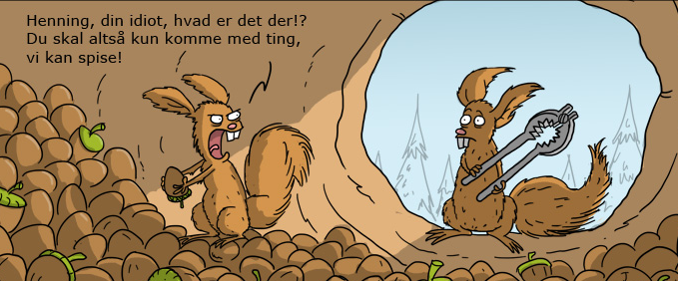
Open for new ideas?
Poul, what's that!?
I said only bring things we can eat!
Notes:
Are you open to new ideas?

Slide 42
IT exists to support the business by support various usecases
Usecases can be categorized as either
”User” intent to manipulate information
”User” intent to find and read information
We already support this in OO at a Property level:
Setter (or mutator) methods Manipulate data
Getter (or accessor) methods Read data
Let’s raise it to a higher Level

Slide 43
CQS
Separation of
functions that write
&
functions that read
Functions that write are called Command methods and must not return a value
Functions that read are called Query methods and must have no side effects

Slide 44
CQS
Commands – Change data
UI
Application
Domain
Data
Queries – Ask for data (no side effects)
UI
Application
Data

Slide 45
CQS from a code perspective
public class CustomerService
{
// Commands
void MakeCustomerPreferred(CustomerId)
void ChangeCustomerLocale(CustomerId, NewLocale)
void CreateCustomer(Customer)
void EditCustomerDetails(CustomerDetails)
// Queries
Customer GetCustomer(CustomerId)
CustomerSet GetCustomersWithName(Name)
CustomerSet GetPreferredCustomers()
}

Slide 46
So what is CQRS?
CQRS is simply the creation of two objects
where there was previously only one
Greg Young

Slide 47
CQRS In its simplest form
public class CustomerWriteService
{
// Commands
void MakeCustomerPreferred(CustomerId)
void ChangeCustomerLocale(CustomerId, NewLocale)
void CreateCustomer(CreateCustomer)
void EditCustomerDetails(CustomerDetails)
}
public class CustomerReadService
{
// Queries
Customer GetCustomer(CustomerId)
CustomerSet GetCustomersWithName(Name)
CustomerSet GetPreferredCustomers()
}

Slide 48
Commands
A Command’s primary goal is to capture
USER INTENT
A Command supports a single usecase and targets a single Aggregate
Commands are stated in the imperative:
  DoStuff
  CreateCustomer
  ShipOrder
  AddComment
  DeleteComment

Slide 49
1. Realization Commands and Queries support very different usecases

Slide 50
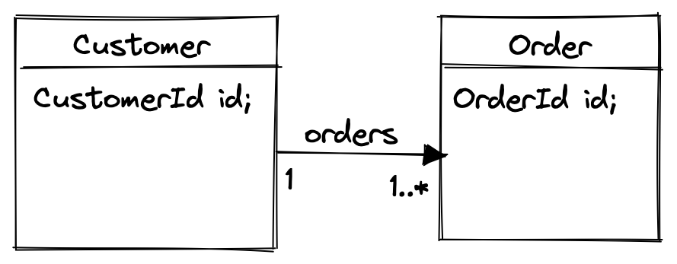
When to use EAGER vs LAZY fetching?
Highly depends on
the use case!
@Entity
public class Customer {
@Id
@Column(name="CUSTOMER_ID")
private CusomterId id;
@OneToMany(fetch = FetchType.LAZY,
mappedBy = "customer")
private Set<Order> orders = new HashSet<>();
}
@Entity
public class Order {
@Id
@Column(name="ORDER_ID")
private OrderId id;
@ManyToOne(fetch = FetchType.EAGER)
@JoinColumn(name="CUSTOMER_ID")
private Customer customer;
}

Slide 51
2. Realization Query results contain only data – no logic
Give me the customer with his last 10 orders
Give me the customer with total sum of orders for the last year
Give me the complete order
Give me the shipping status for the order
Give me the customers last review
So why go through the domain layer?
UI
Application
Data

Slide 52
Things to think about in relation to Queries
Why take the pain of performing JOINS and/or UNIONS of our nicely normalized Relational Model?
Why not having a completely denormalized data model (or View) to support our Query?
When we completely denormalize our data, do we really need a relational database or could we use a Key/Value- or Document Store?
Do we need our Read Data to up to the microsecond consistent with our Write data?

Slide 53
So how is this relevant in the real world?
Let’s look at a real life scenario

Slide 54






Collaborative domains
1. Read
2. Read
4. Update
3. Coffee time
5. Stale data

Slide 55
We’re working with stale data
Optimistic Locking Exception
Notes:
Why is this the best we can offer – Why should the user be interrupted by a technical constraint?

Slide 56




We’re always working with stale data!
+ thinking time (1000-1500 ms)
20 ms
20 ms
At this point our data is at least
120 ms stale
+
Thinking time
1 ms
1 ms
100 ms
100 ms
100 ms

Slide 57
Let’s use stale data to our advantage by offloading the database by using our read models
Commands – Change data
UI
Application
Domain
Write model
Queries – Ask for data (no side effects)
UI
Application
Read models

Slide 58
All we need is a good way to synchronize our write and read models
Commands – Change data
UI
Application
Domain
Write model
Queries – Ask for data (no side effects)
UI
Application
Read models

Slide 59
Commands & Events
Commands mutate Aggregate state which results in one or more Events being issued/published.
Command | Event(s)
AcceptOrder | OrderAccepted
ShipOrder | OrderShipped
AddComment | CommentAdded
QuarantineReview | ReviewQuarantined
UnquarantineReview | ReviewUnquarantined

Slide 60

Commands, Events and Query Models
UI
”Find all
Accepted Orders”
Query
”AcceptOrder”
command
Queries
Commands
Query model
Domain model
Read model
Events
Read model
”OrderAccepted”
event
Commands are Imperative: DoStuff
Events are Past tense: StuffDone

Slide 61
View projections in cqrs
CQRS Principle:
  Command Query Responsibility Segregation suggests separating the responsibility of handling commands (write operations) from that of handling queries (read operations).
Transaction vs. Query Optimization:
  The requirements for optimizing a system for transactional operations (writes) are often different from those for query and reporting operations (reads).
Read Models / View Projections based on Event Streams have the following advantages:
  Very simple queries (select * from [read_model] where …)
  Existing View projections can easily be rebuilt by replaying events
  New View Projection can be built by replaying events
Things to consider:
  Projections should receive events in order
  Projections should never miss an event
  Projections should handle duplicate events - aka idempotence

Slide 62
CQRS + eventsourcing example
CommandBus
ChangeProductPriceDecider
fetchEventStream
Event
Store
Change
Product
Price
ProductPriceChange
appendToStream
Products
For
Sale
View
Query
ProductsForSaleView
Evolver
subscribe
ProductPriceChanged

Slide 63
View Projections
The Evolver pattern plays a crucial role in projecting past events into a view projection or aggregate state
EVOLVER pattern
@Component
class ProductsForSaleViewEvolver(
val productsForSaleViewRepository: ProductsForSaleViewRepository,
…
) : EventProcessor(…) {
override fun reactsToEventsRelatedToAggregateTypes(): List<AggregateType> {
return listOf(AggregateType("Product"))
}
@MessageHandler
fun handle(e: ProductAdded, orderedMessage: OrderedMessage) {
…
}
@MessageHandler
fun handle(e: ProductPriceChanged, orderedMessage: OrderedMessage) {
…
}
}

Slide 64
VIEW
view
View repository
@Entity(name = "products_for_sale_view")
data class ProductForSaleView(
@Id val id: String,
var name: String,
var price: Amount,
var version: Long,
var lastUpdated: ZonedDateTime,
)
interface ProductsForSaleViewRepository :
JpaRepository<ProductForSaleView, String> {
}

Slide 65
View Projections
EVOLVER pattern
@Component
class ProductsForSaleViewEvolver(
val productsForSaleViewRepository: ProductsForSaleViewRepository,
…
) : EventProcessor(…) {
@MessageHandler
fun handle(e: ProductAdded, orderedMessage: OrderedMessage) {
if (!productsForSaleViewRepository.existsById(e.id.value)) {
productsForSaleViewRepository.save(
ProductForSaleView(
e.id.value,
e.name,
e.price,
orderedMessage.order,
orderedMessage.getMessageTimestamp()
)
)
}
}
}
Idempotent

Slide 66
View Projections
EVOLVER pattern
@Component
class ProductsForSaleViewEvolver(
val productsForSaleViewRepository: ProductsForSaleViewRepository,
…
) : EventProcessor(…) {
@MessageHandler
fun handle(e: ProductPriceChanged, orderedMessage: OrderedMessage) {
var productForSale = productsForSaleViewRepository.findById(e.id.value).orElseThrow()
if (productForSale.version == orderedMessage.order) {
// Idempotent handling
return
}
if (productForSale.version + 1 == orderedMessage.order) {
productForSale.price = e.price
productForSale.version = orderedMessage.order
productsForSaleViewRepository.save(productForSale)
} else {
throw EventOutOfOrderException(
ProductConfiguration.AGGREGATE_TYPE,
e.id.toString(),
ProductPriceChanged::class,
expectedEventOrder = productForSale.version + 1,
actualEventOrder = orderedMessage.order
)
}
}
}

Slide 67
View Projections
EVOLVER pattern
@Component
class ProductsForSaleViewEvolver(
val productsForSaleViewRepository: ProductsForSaleViewRepository,
…
) : EventProcessor(…) {
@MessageHandler
fun handle(e: ProductPriceChanged, orderedMessage: OrderedMessage) {
var productForSale = productsForSaleViewRepository.findById(e.id.value).orElseThrow()
if (productForSale.version == orderedMessage.order) {
// Idempotent handling
return
}
productForSale.price = e.price
productForSale.version = orderedMessage.order
productsForSaleViewRepository.save(productForSale)
}
}

Slide 68
State projection within a decider
EVOLVER pattern
class RemoveItemFromShoppingBasketDecider : Decider<RemoveItemFromShoppingBasket, ShoppingBasketEvent> {
override fun handle(cmd: RemoveItemFromShoppingBasket, events: List<ShoppingBasketEvent>): ItemRemovedFromShoppingBasket? {
var productQuantities: MutableMap<ProductId, Int> = Evolver.applyEvents(
ProductQuantityEvolver(),
mutableMapOf(),
events
)
var productQuantity = productQuantities[cmd.product] ?: 0
return if (productQuantity > 0)
ItemRemovedFromShoppingBasket(
cmd.id,
cmd.product
)
else null
}
}

Slide 69
State projection within a decider
EVOLVER pattern
var productQuantities: MutableMap<ProductId, Int> =
Evolver.applyEvents
ProductQuantityEvolver(),
mutableMapOf(),
events)
fun ProductQuantityEvolver() =
Evolver<ShoppingBasketEvent, MutableMap<ProductId, Int>> { event, currentState ->
when (event) {
is ItemAddedToShoppingBasket -> currentState?.set(
event.product,
(currentState[event.product] ?: 0) + 1
)
is ItemRemovedFromShoppingBasket -> {
currentState?.set(
event.product,
(currentState[event.product] ?: 0) - 1
)
if ((currentState?.get(event.product) ?: 0) == 0) {
currentState?.remove(event.product)
}
}
}
return currentState
}

Slide 70
Event modeling - Implementation slicing
Web App
Add Item to
Shopping Basket
(basketId, productId)
Request CheckOut
(baskedId, orderId)
Add Shipping Details to Order
(orderId,
shippingAddress,
shippingMethod)
Shopping Basket
(basketId,…)
Shopping Basket
(basketId, orderId,…)
Order
Shipping Details
(orderId,…)
Item Added to Shopping Basket
(basketId, productId)
CheckOut
Requested
(basketId, orderId)
Sales
ShippingDetailsAdded
(orderId,
shippingAddress,
shippingMethod)
Shipping
Payment

Slide 71
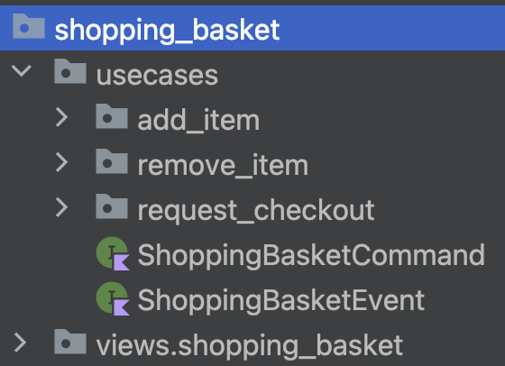
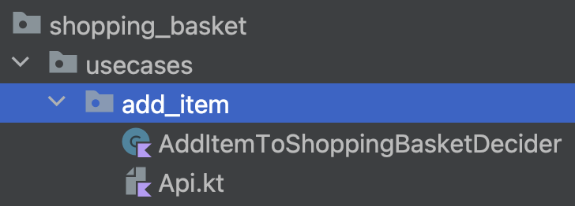
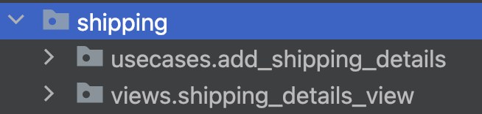
Event modeling - Implementation slicing
Web App
Add Item to
Shopping Basket
(basketId, productId)
Request CheckOut
(orderId, basketId)
Add Shipping Details to Order
(orderId,
shippingAddress,
shippingMethod)
Shopping Basket
(basketId,…)
Shopping Basket
(basketId, orderId,…)
Order
Shipping Details
(orderId,…)
Item Added to Shopping Basket
(basketId, productId)
CheckOut
Requested
(orderId, basketId)
Sales
Shipping
ShippingDetailsAdded
(orderId,
shippingAddress,
shippingMethod)
Payment

Slide 72
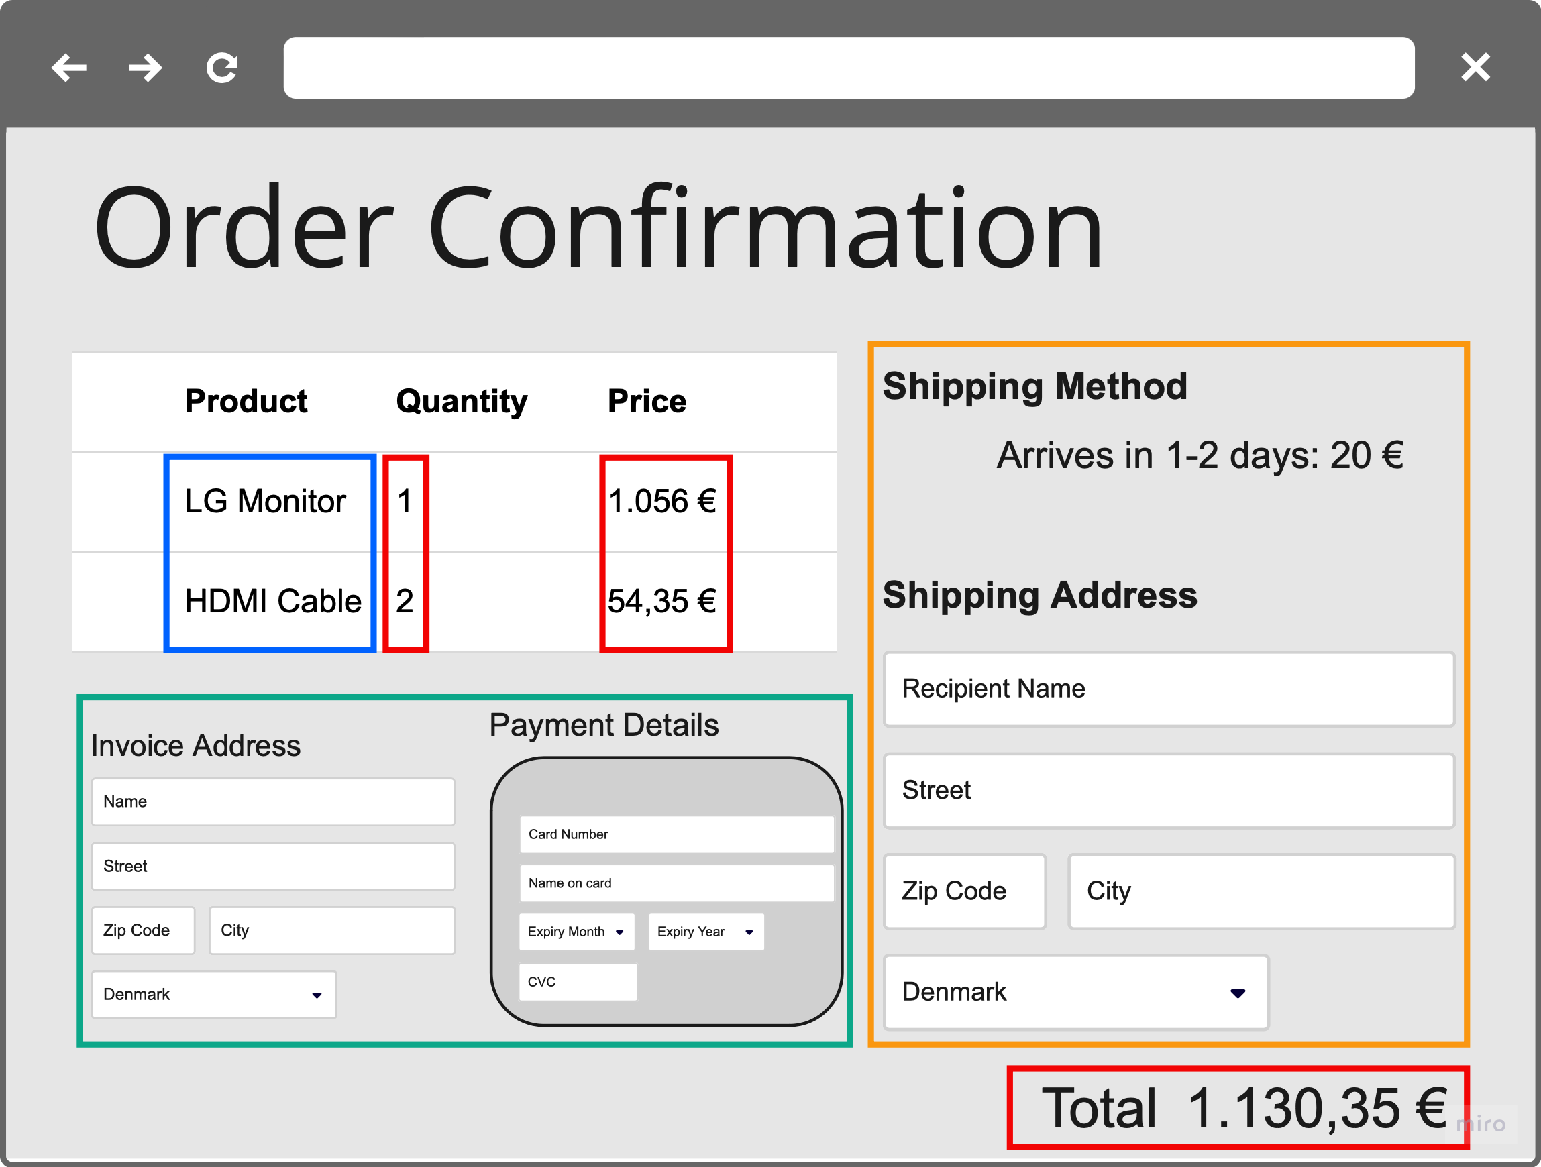
Event modeling
Web App
Add Payment Details to Order
(orderId,
invoiceAddress,
paymentMethod)
PlaceOrder
(orderId)
Orders
Ready for Packaging
(orderId)
Package Order
(orderId)
Order Payment Details
(orderId,…)
Order
(orderId)
Sales
OrderPlaced
(orderId)
Shipping
Order Packaging Requested
(orderId)
PaymentDetailsAdded
(orderId,
invoiceAddress,
paymentMethod)
Payment

Slide 73
Composite UI

Slide 74
Automated processes
OrdersAwaiting
HoldOnCreditCard
(orderId)
Place hold on credit card
(orderId)
OrderPlaced
(orderId)

Slide 75
IT-OPS INTEGRATION
Payment Gateway
IT Ops
Place hold on credit card
OrderPlaced
OrderId
Request/Response
(preferably in memory)
Payment Information And Status Provider
Order Total Provider
Payment
Sales

Slide 76
Exercise 3

Slide 77
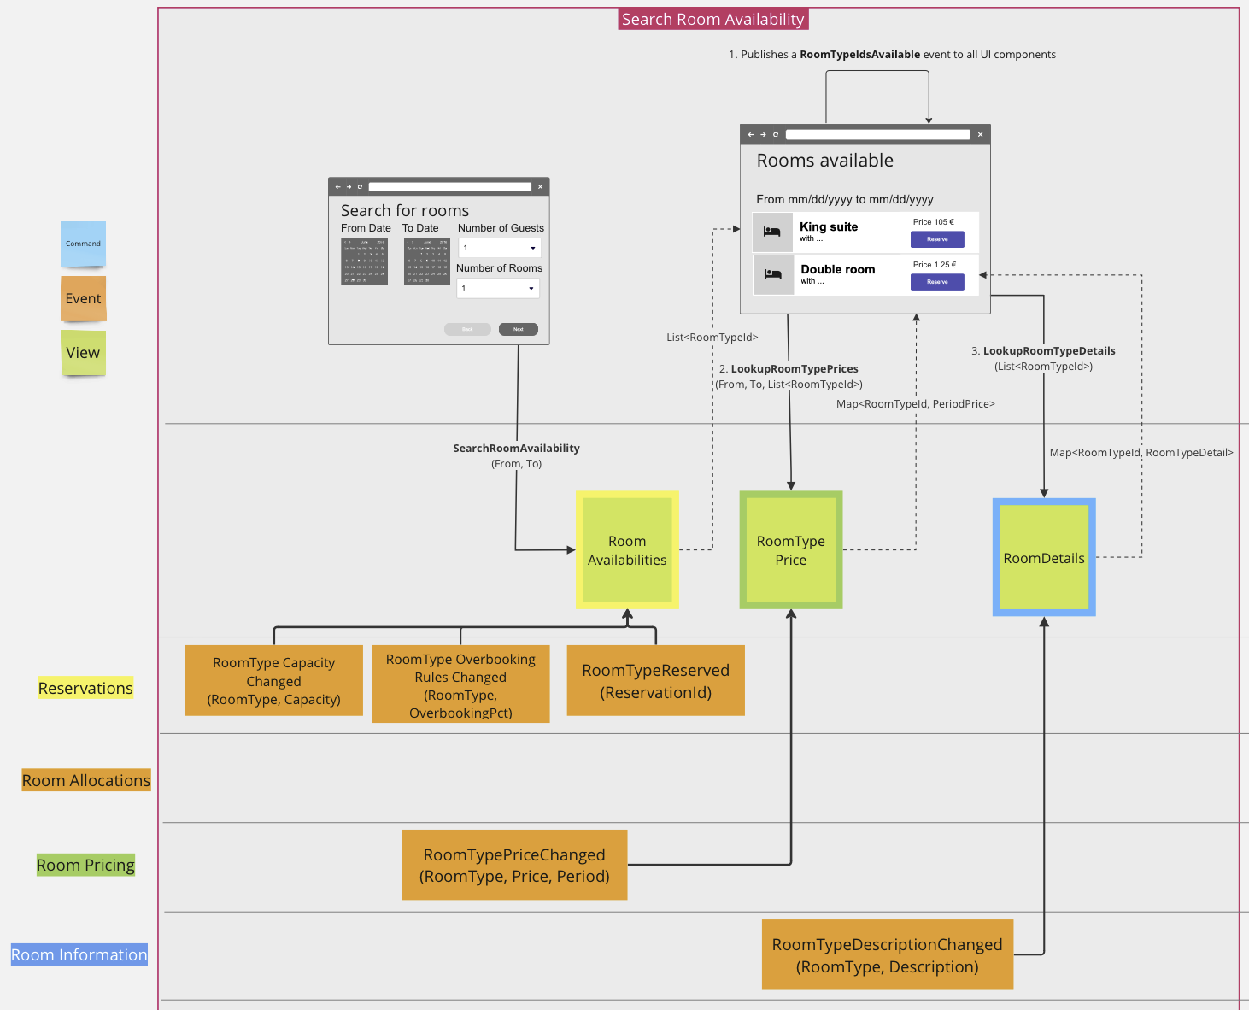
Execise 2 –
Event modeling flow

Slide 78
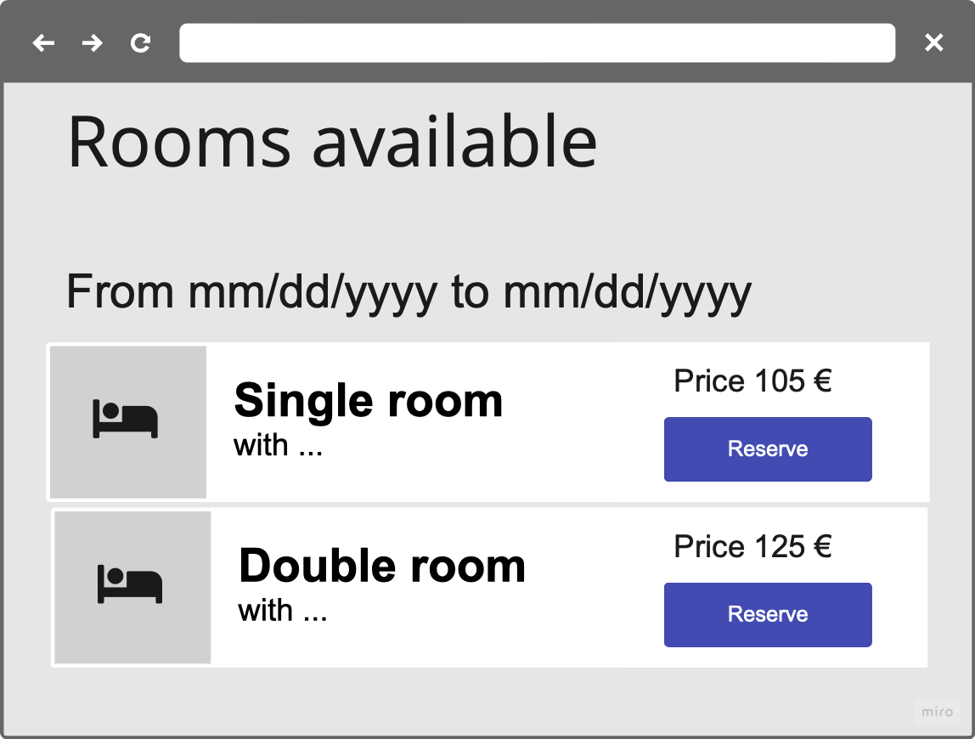
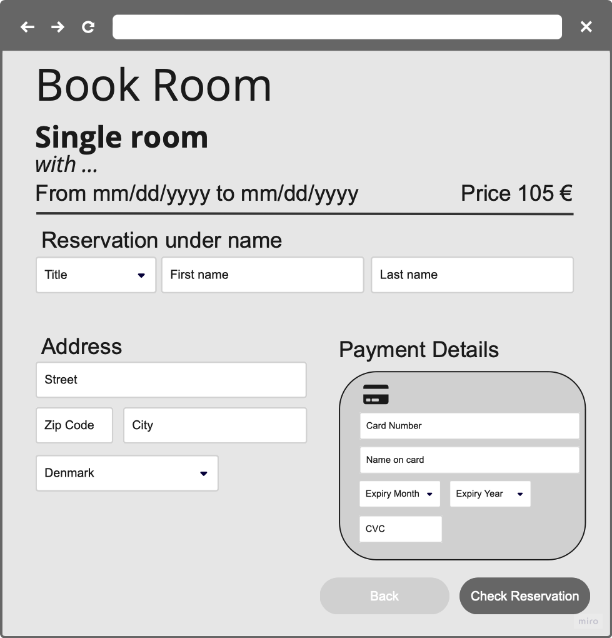
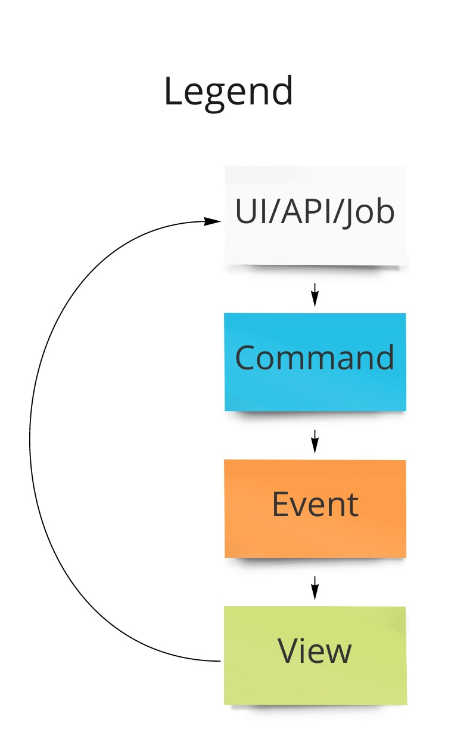
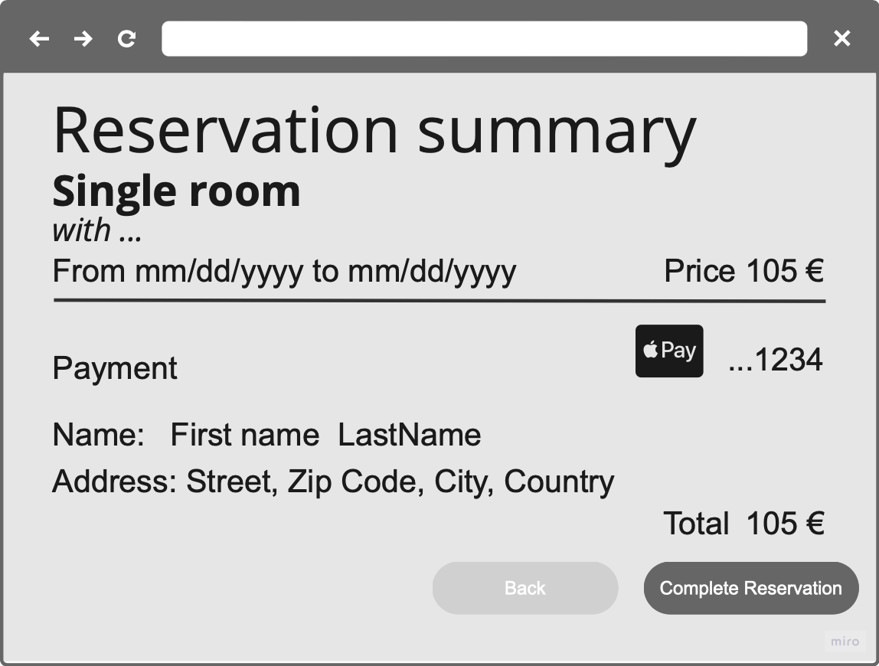
Exercise 3
Use case: Book room
Add guest information
Add Credit card information to perform a hold on the card to confirm the reservation
Reservation Summary
Complete Reservation
What about:
Transactional consistency in relation to the reservation
Overbooking strategies – what’s the overbooking threshold?

Slide 79

Exercise 3 – Design 1/2
registerReservationInProgress(reservationId,
roomTypeId,
fromDate, toDate)
Yellow
Store Cookie in Browser / Publish ReserveRoomType (event)
{
ReservationId: in-browser-generated-reversation-id,
RoomTypeId: reserveRoomTypeWithId,
Date fromDate,
Date toDate
}
registerPaymentDetails(
reservationId,
paymentDetails
)
registerGuestDetails(reservationId,
guestDetails)
Purple
Red

Slide 80
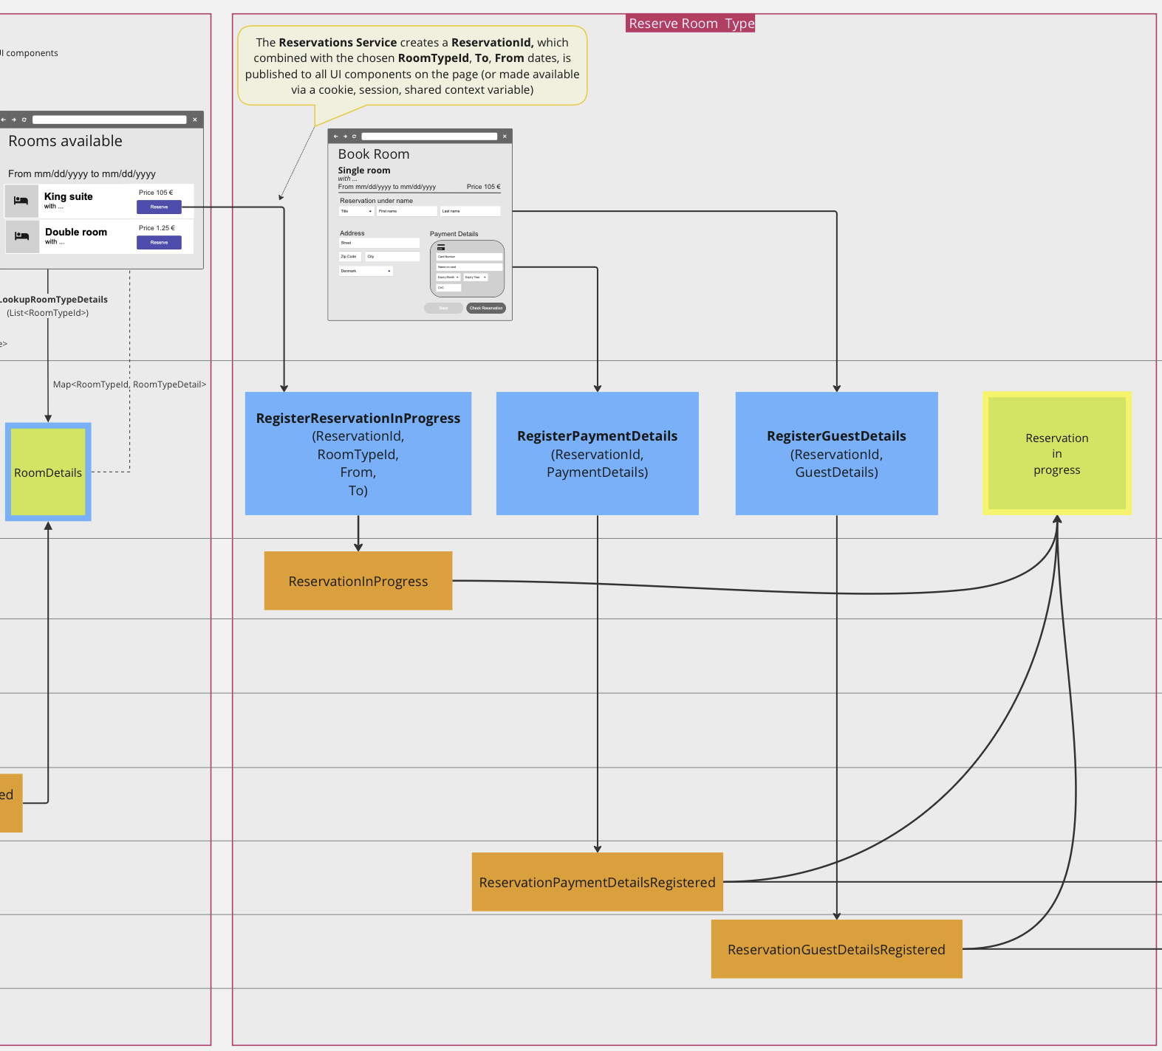

Hotel Booking
Book Room 1/2

Slide 81
Exercise 3 – Design 2/2
completeReservation(reservationId)
Yellow

Slide 82
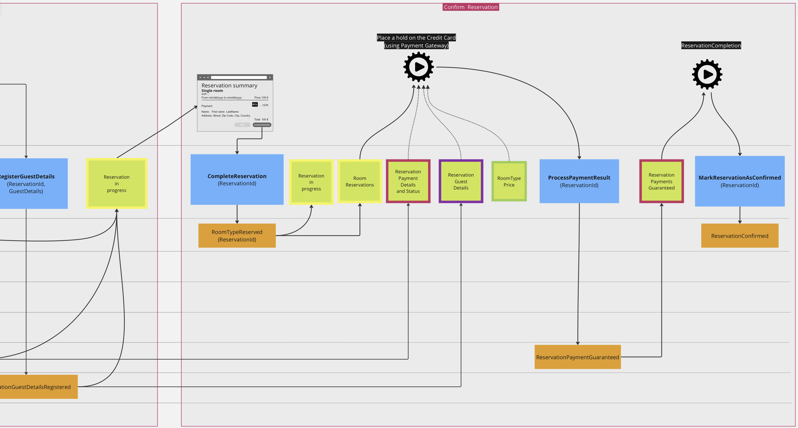
Hotel Booking
Book Room 2/2

Slide 83
IT-OPS integration
Payment Gateway
IT Ops
Place hold on credit card
RoomTypeReserved
ReservationId
Request/Response
(preferably in memory)
Reservation Information Provider
Payment Information And Status Provider
Reservation Total Provider
Reservation information
Payment
Price Information

Slide 84
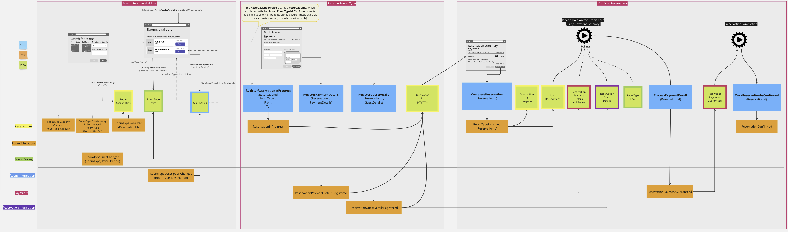
Hotel Booking – Full flow

Slide 85
Event sourcing
and the dual write problem

Slide 86


Dual write problem with Event Sourcing
Transaction boundary
Transaction boundary
Client
Billing
Service
Order
Service
Requires only local transactions
Natively event driven: The Service consumes and produces events
Proven Audit Trail
Flexible and adaptable
Captures business intentions as events
Requires idempotent operations
Send- Invoice
Save-Order
Async Push or Pull
Event Store

Slide 87
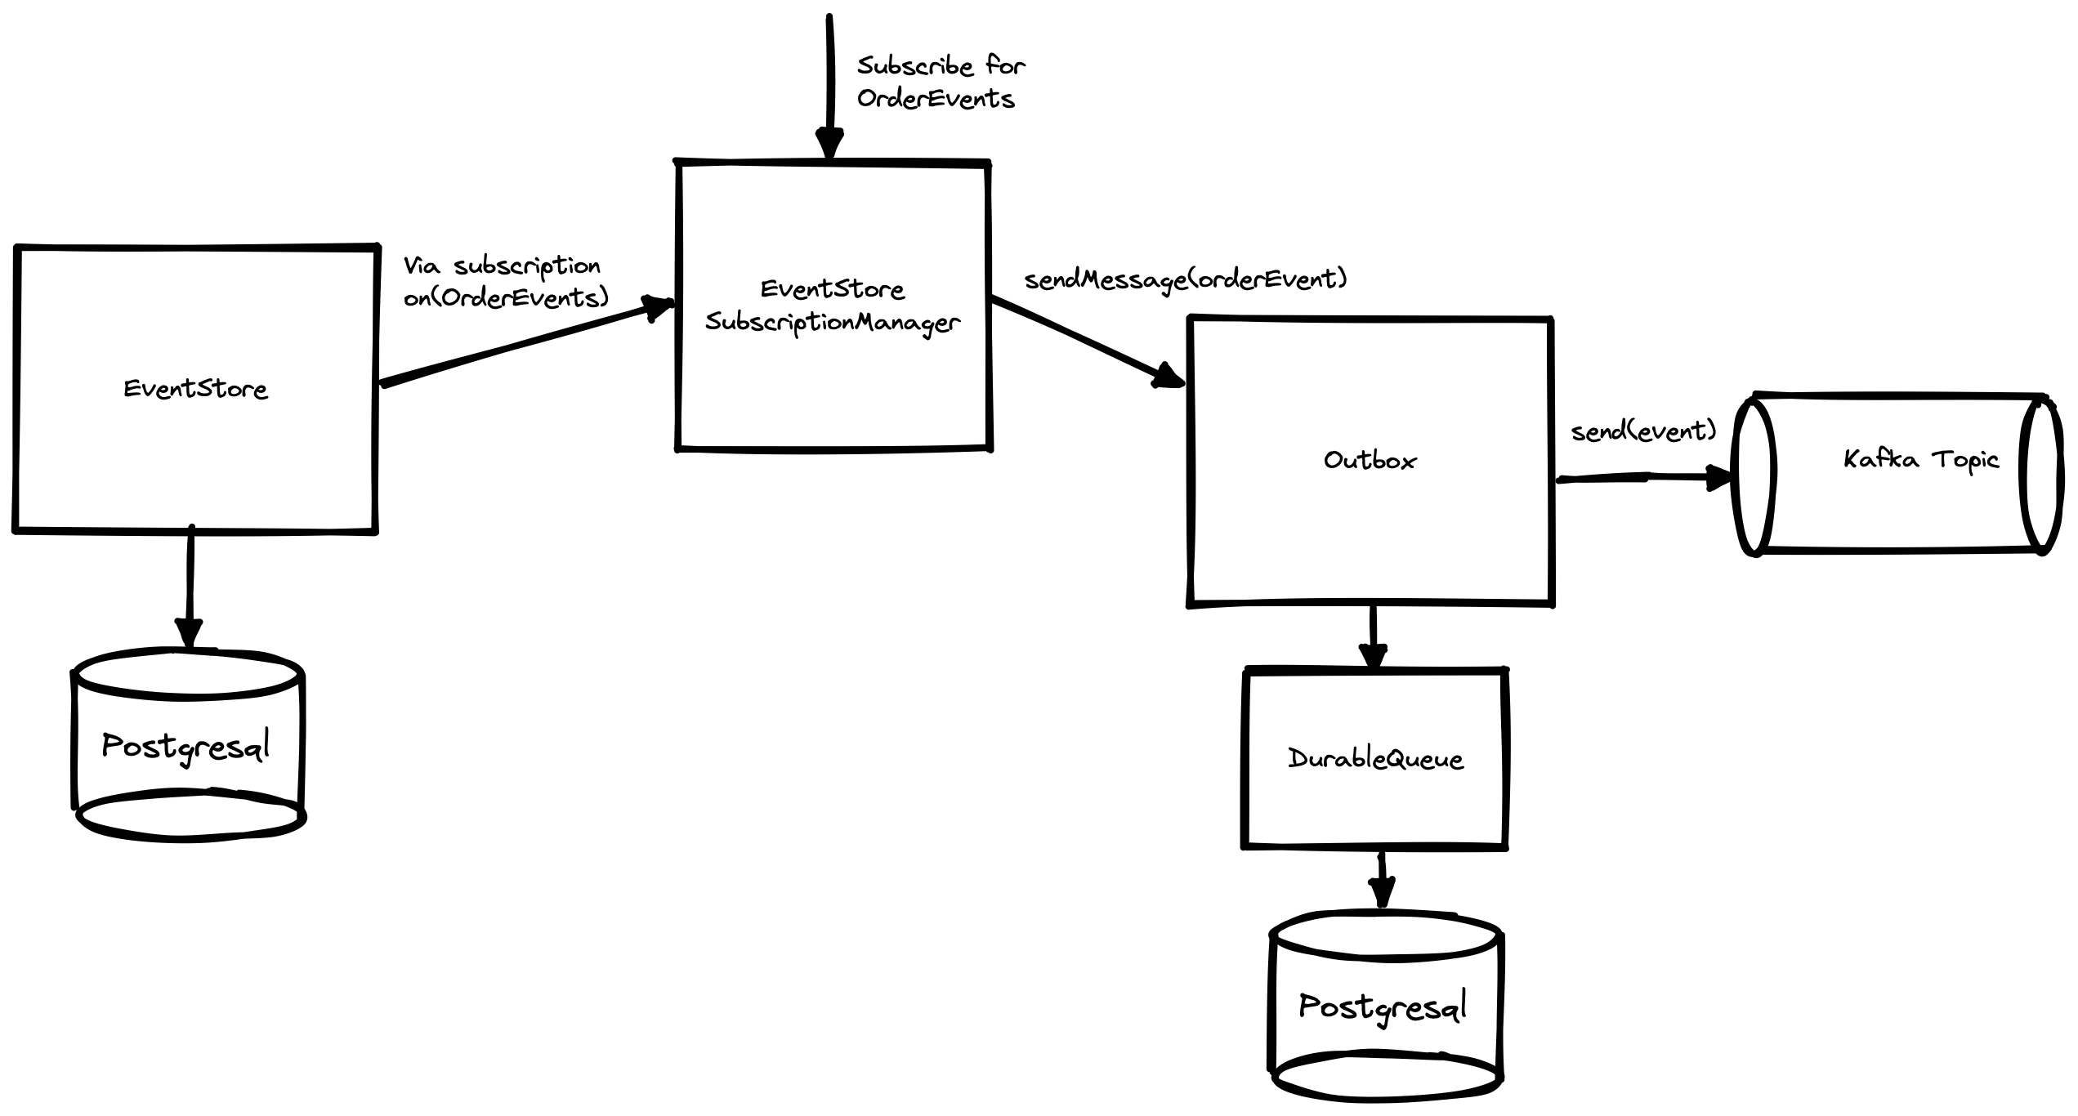
Publish events to an eventbus (e.g. Kafka)
EventProcessor

Slide 88
Publish events to an eventbus (e.g. Kafka)
@Service
public class ShippingEventKafkaPublisher extends EventProcessor {
private final KafkaTemplate<String, Object> kafkaTemplate;
public ShippingEventKafkaPublisher(…,
@NonNull KafkaTemplate<String, Object> kafkaTemplate) {
super(…);
this.kafkaTemplate = kafkaTemplate;
}
@Override
protected List<AggregateType> reactsToEventsRelatedToAggregateTypes() {
return List.of(ShippingOrders.AGGREGATE_TYPE);
}
@MessageHandler
void handle(OrderShipped e, OrderedMessage eventMessage) {
var externalEvent = new ExternalOrderShipped(e.orderId, eventMessage.getOrder());
var producerRecord = new ProducerRecord<String, Object>("shipping-events",
externalEvent.orderId.toString(),
externalEvent);
kafkaTemplate.send(producerRecord);
}
}

